Slide 1



Slide 2
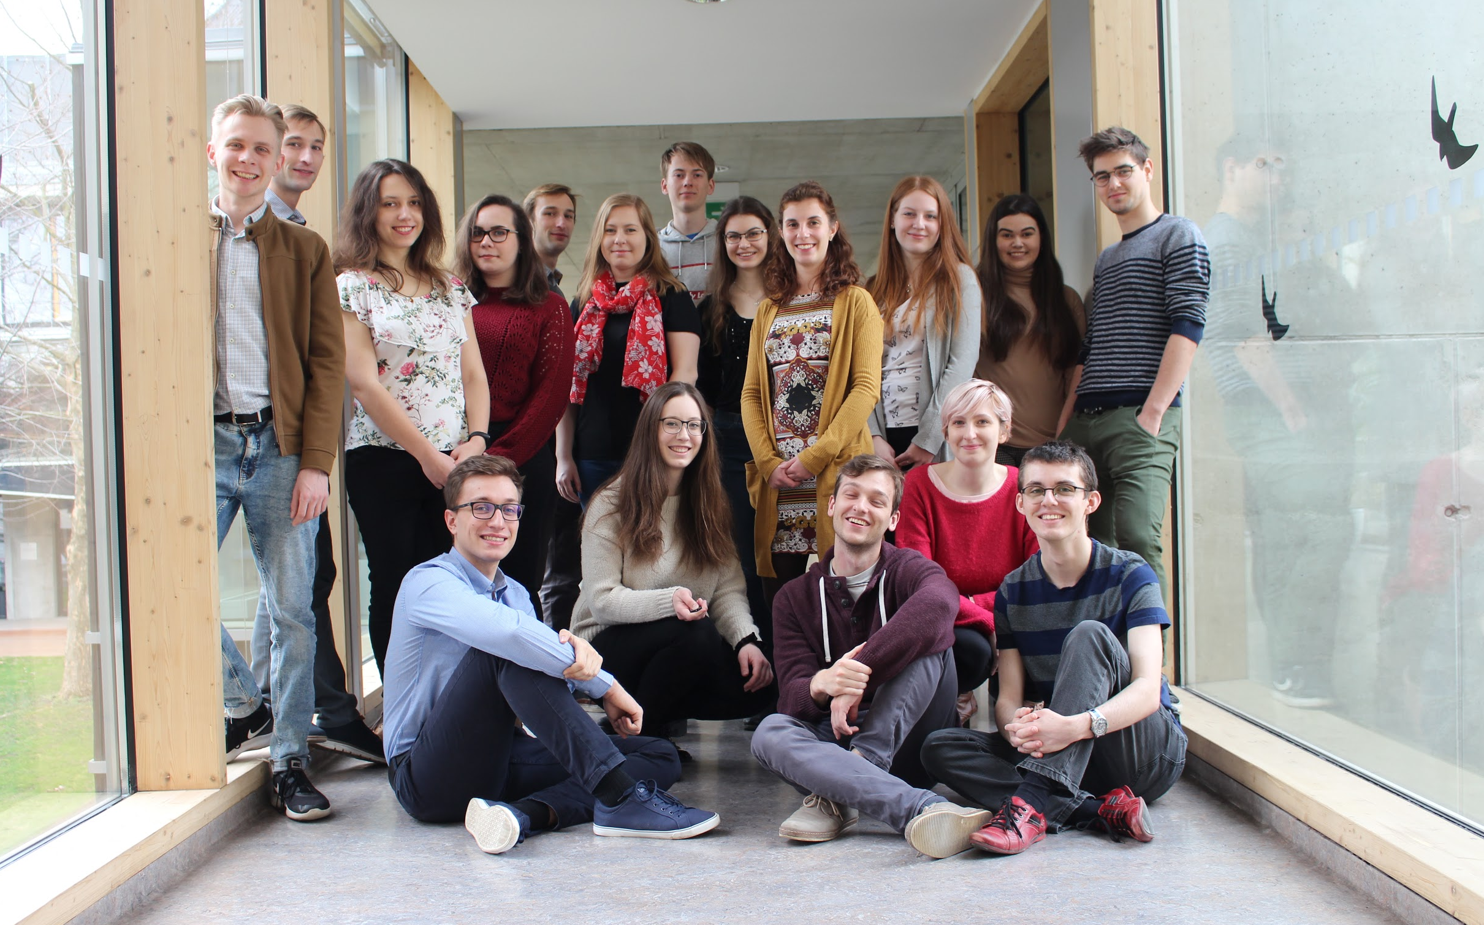

Slide 3









Who supports us

Slide 4
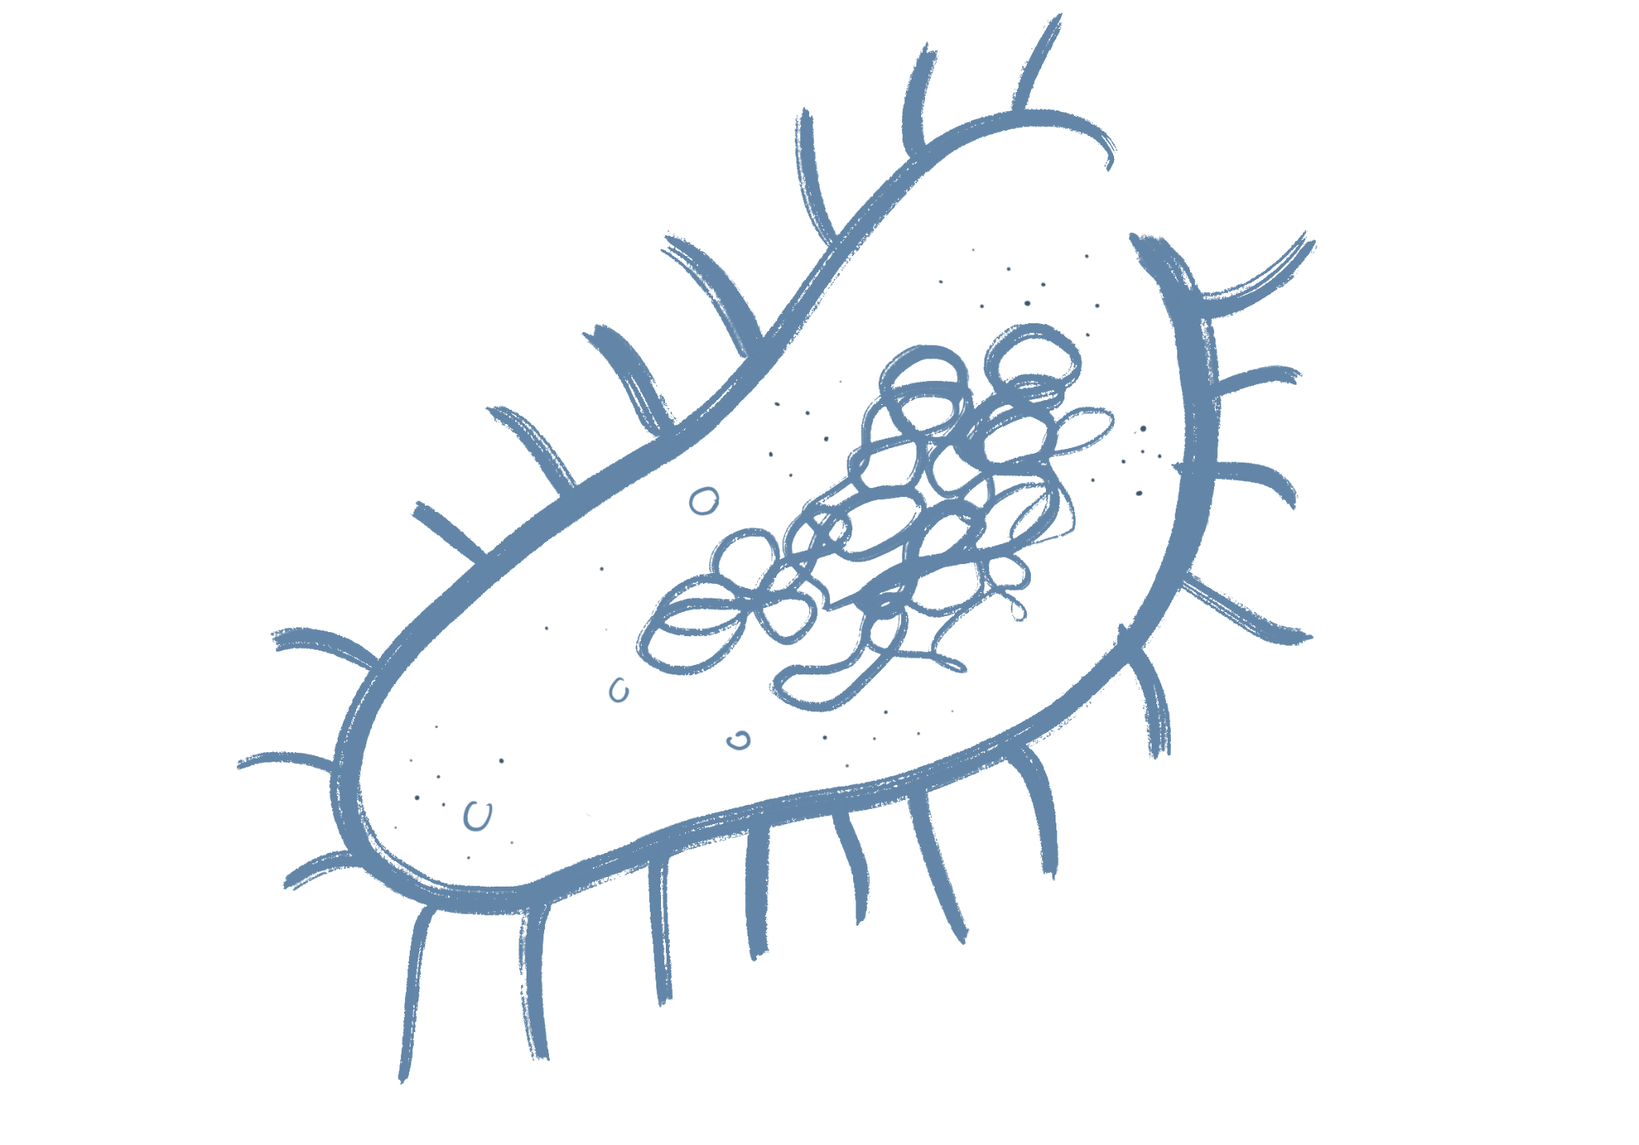
What awaits us today?
Biology of genetic modifications
Application of GMOs
Myths, Mystifications and FAQ
Legislation around GMOs
The future and our project
Discussion

Slide 5
GMO = GENETICALLY MODIFIED ORGANISM

Slide 6

Genetically modified organisms are organisms whose genetic material has been altered in a way that does not result from natural cross-breeding or natural recombination.
Exception Induced mutagenesis
"Natural GMOs" - sweet potatoes, moths

Slide 7
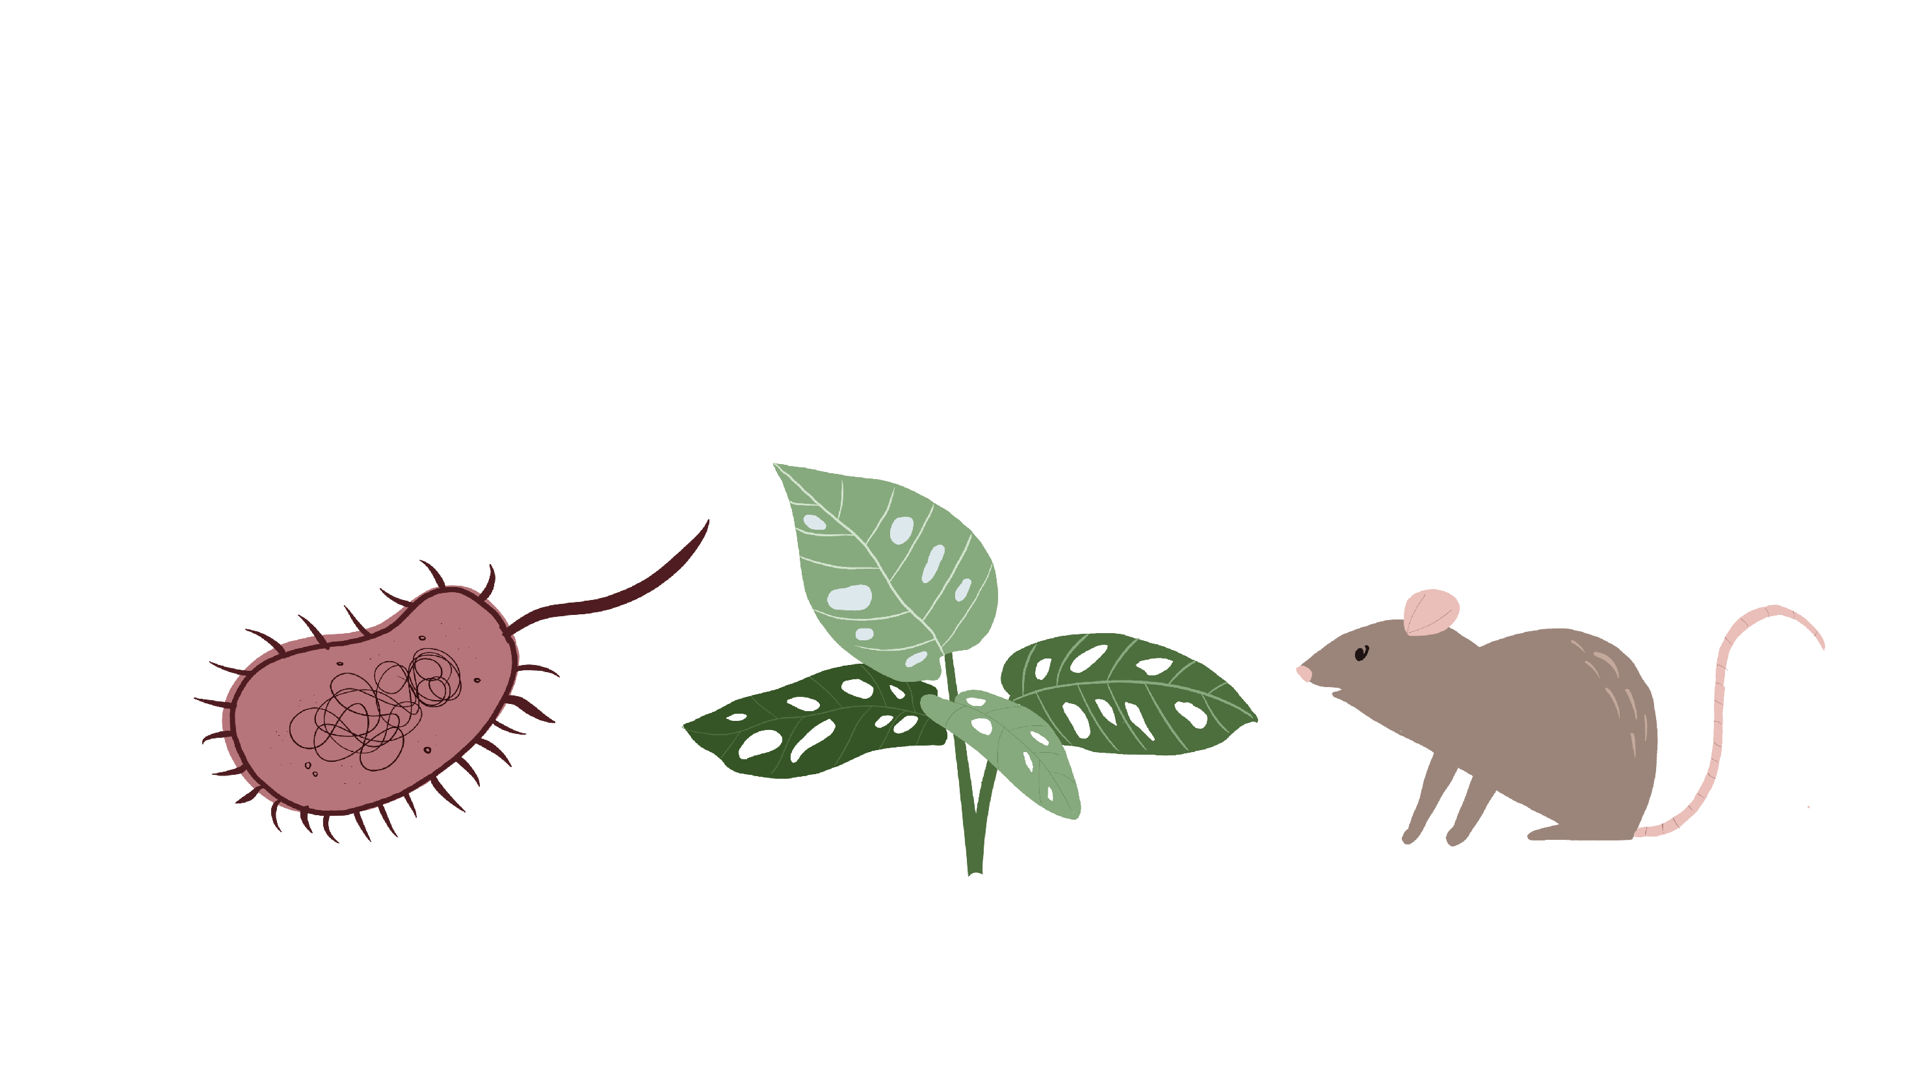
What is a living organism?

Slide 8
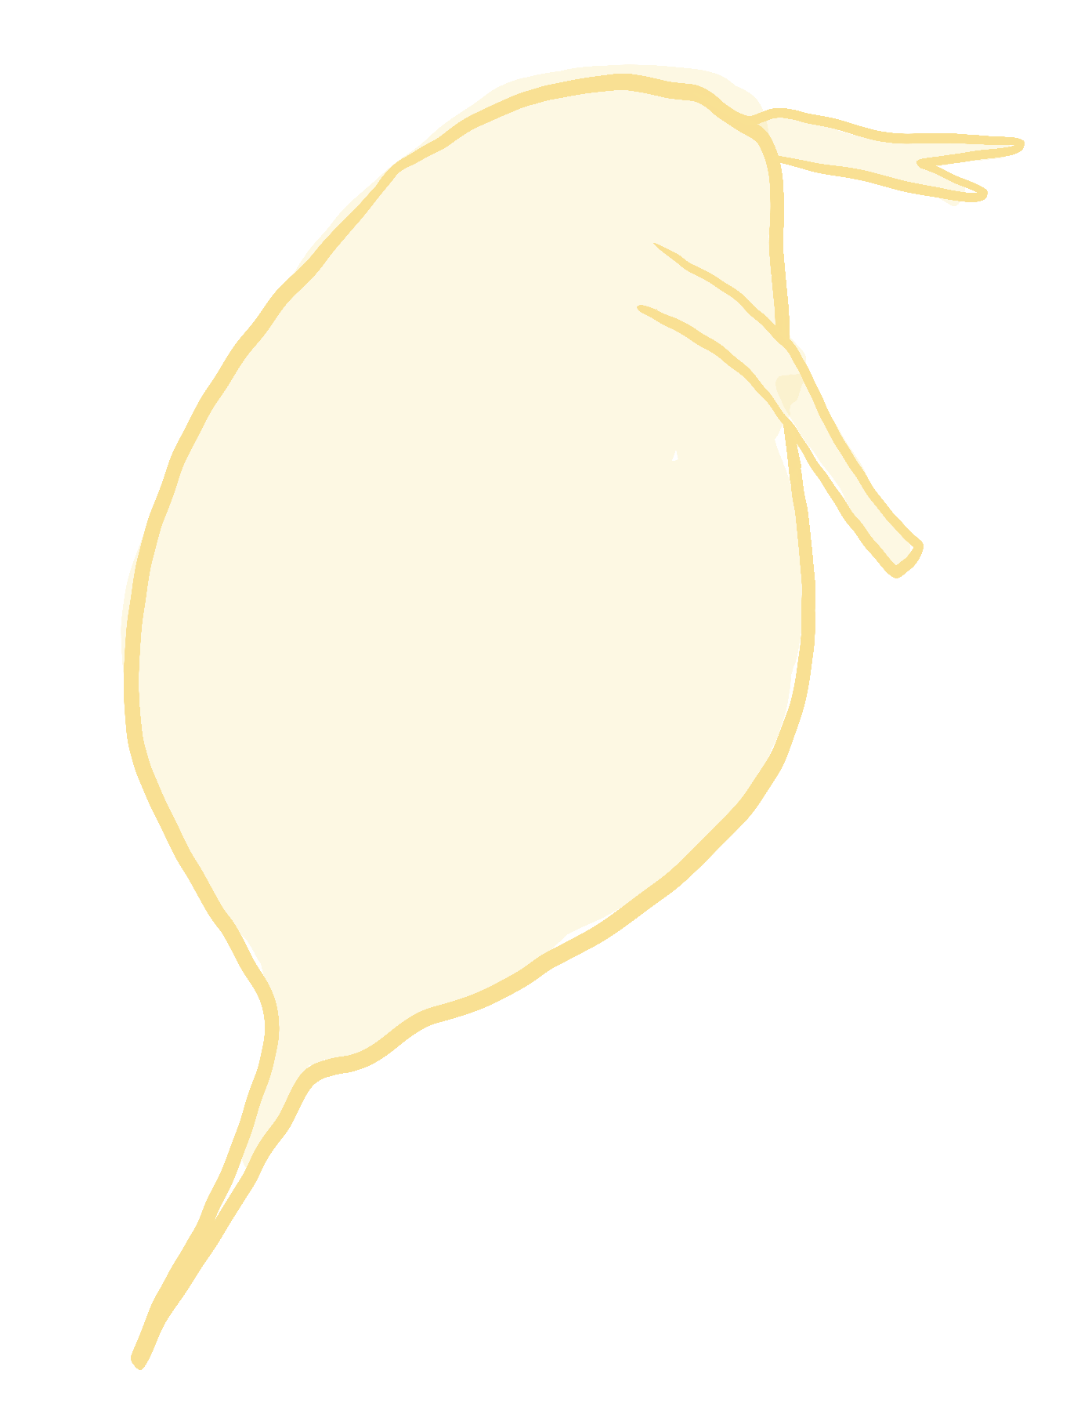
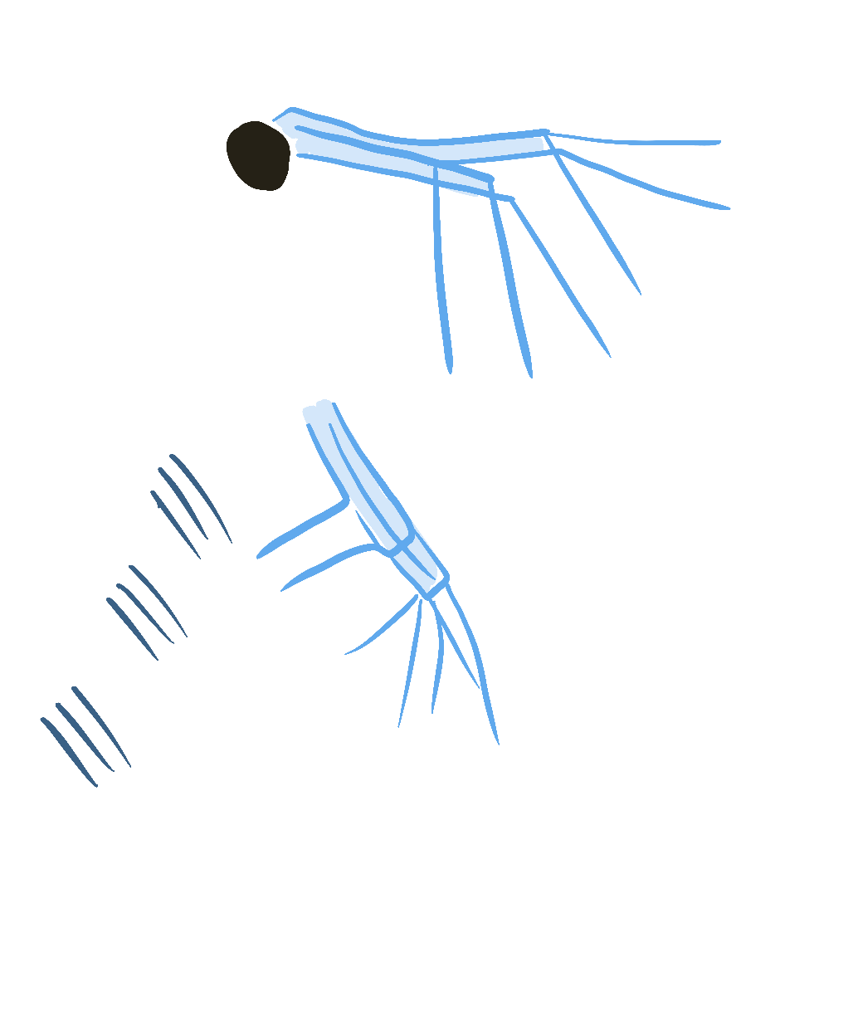
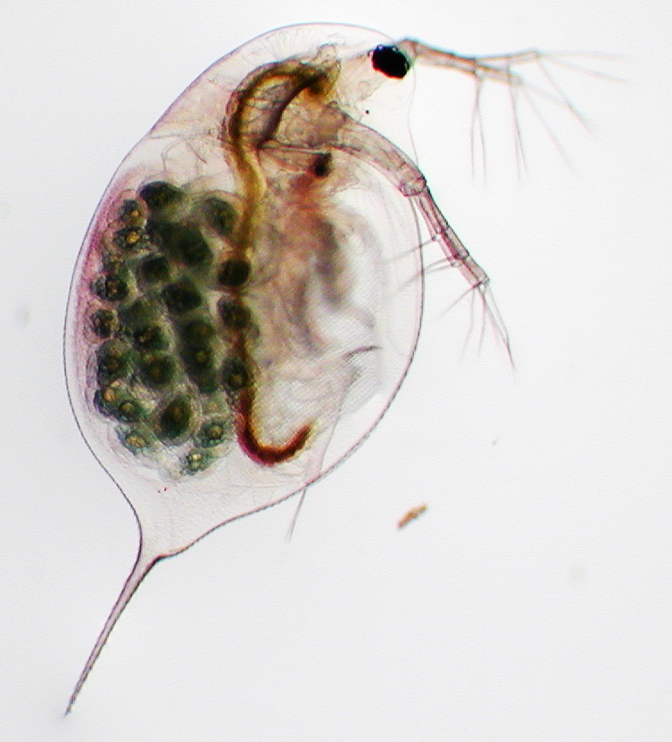
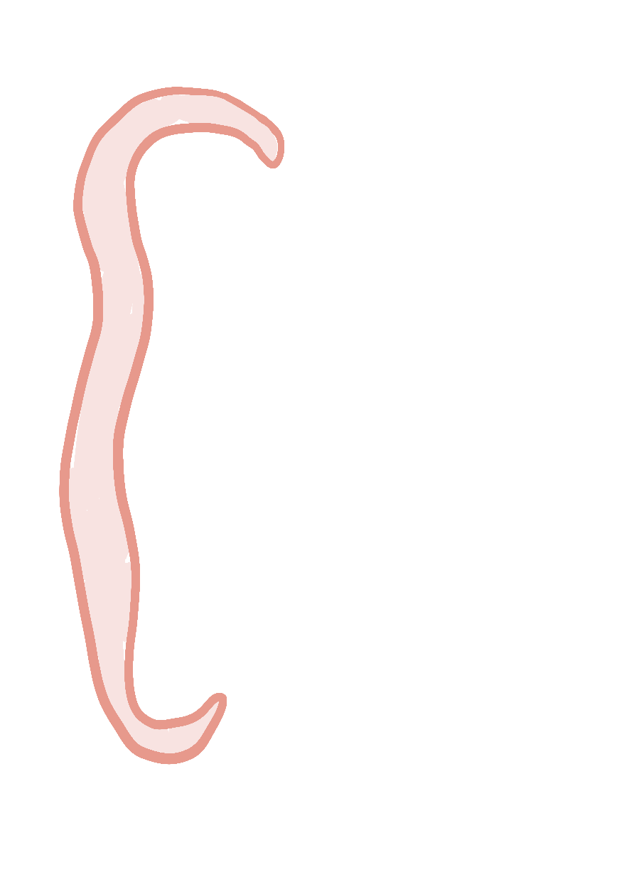
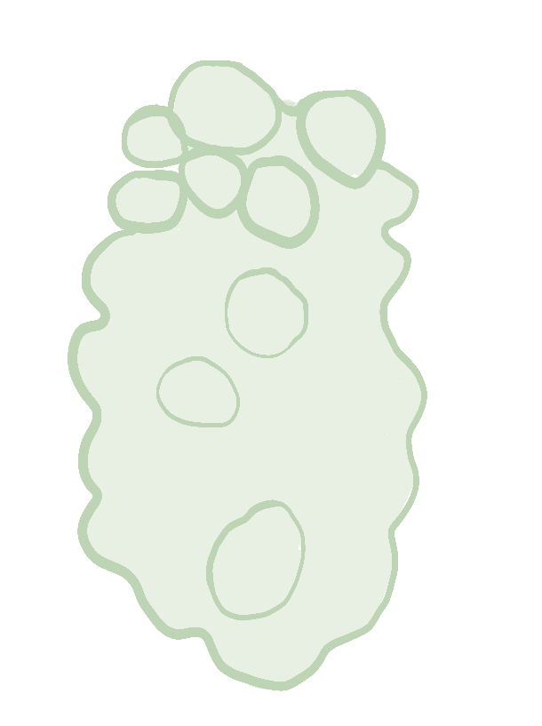
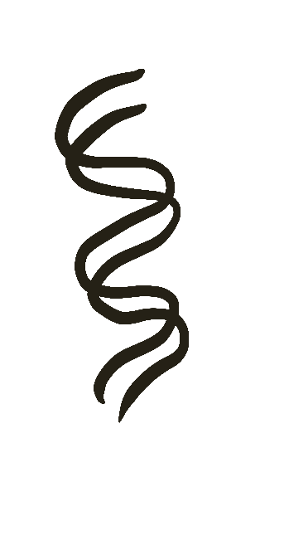
Reproduction
Metabolism
Ability to evolve
Receiving information from the environment
Exchange of substances and energy with the environment

Slide 9
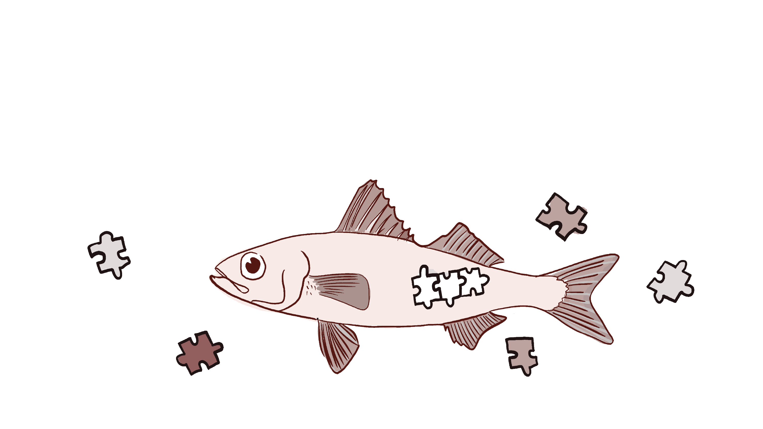
What does the organism consist of?

Slide 10
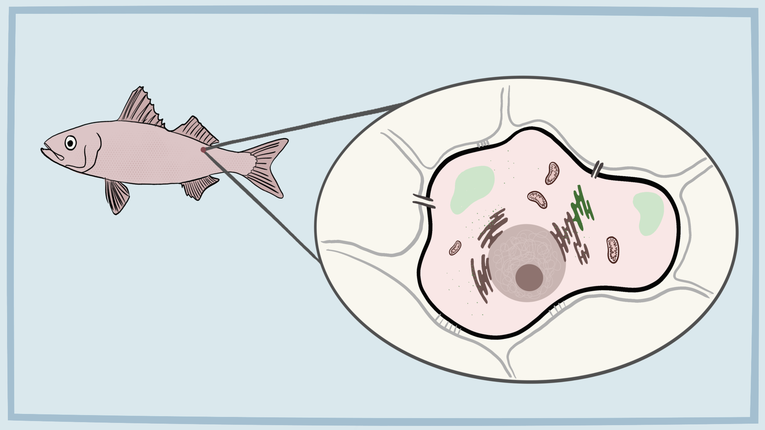

Slide 11
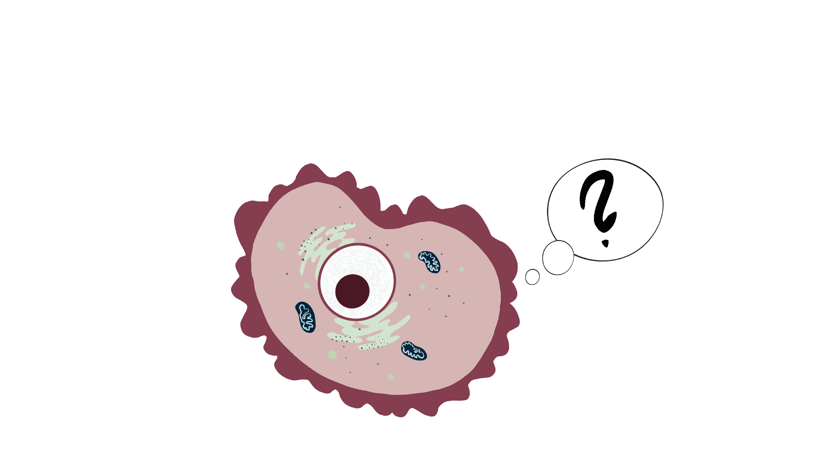
How does the cell know what to do?

Slide 12
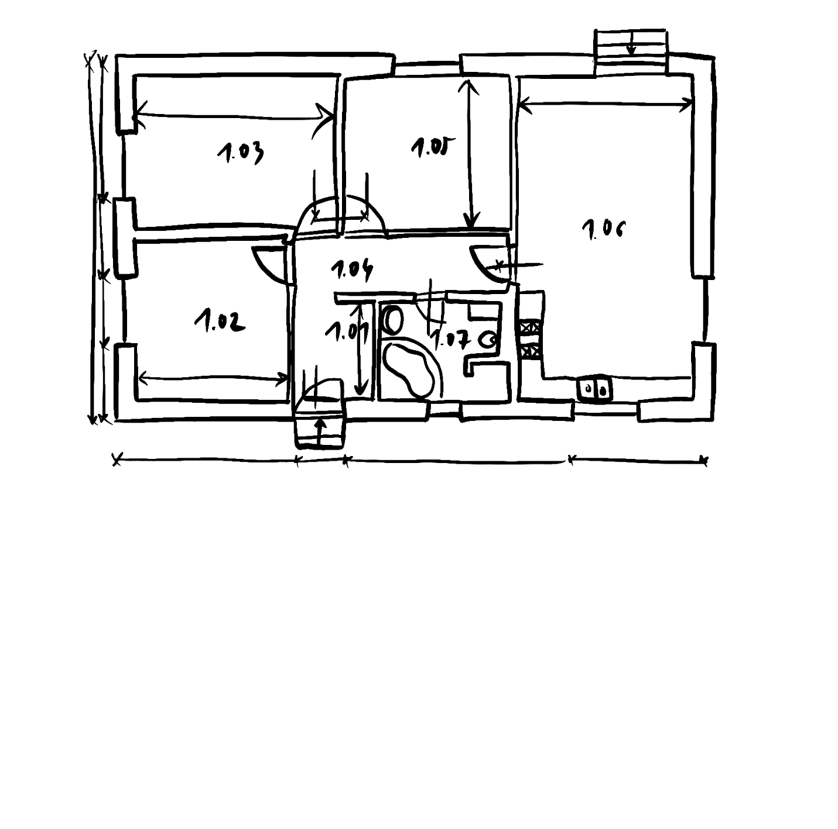
DNA as a building plan
DNA = carrier of hereditary information
Gene = basic unit that determines the characteristics of an individual

Slide 13
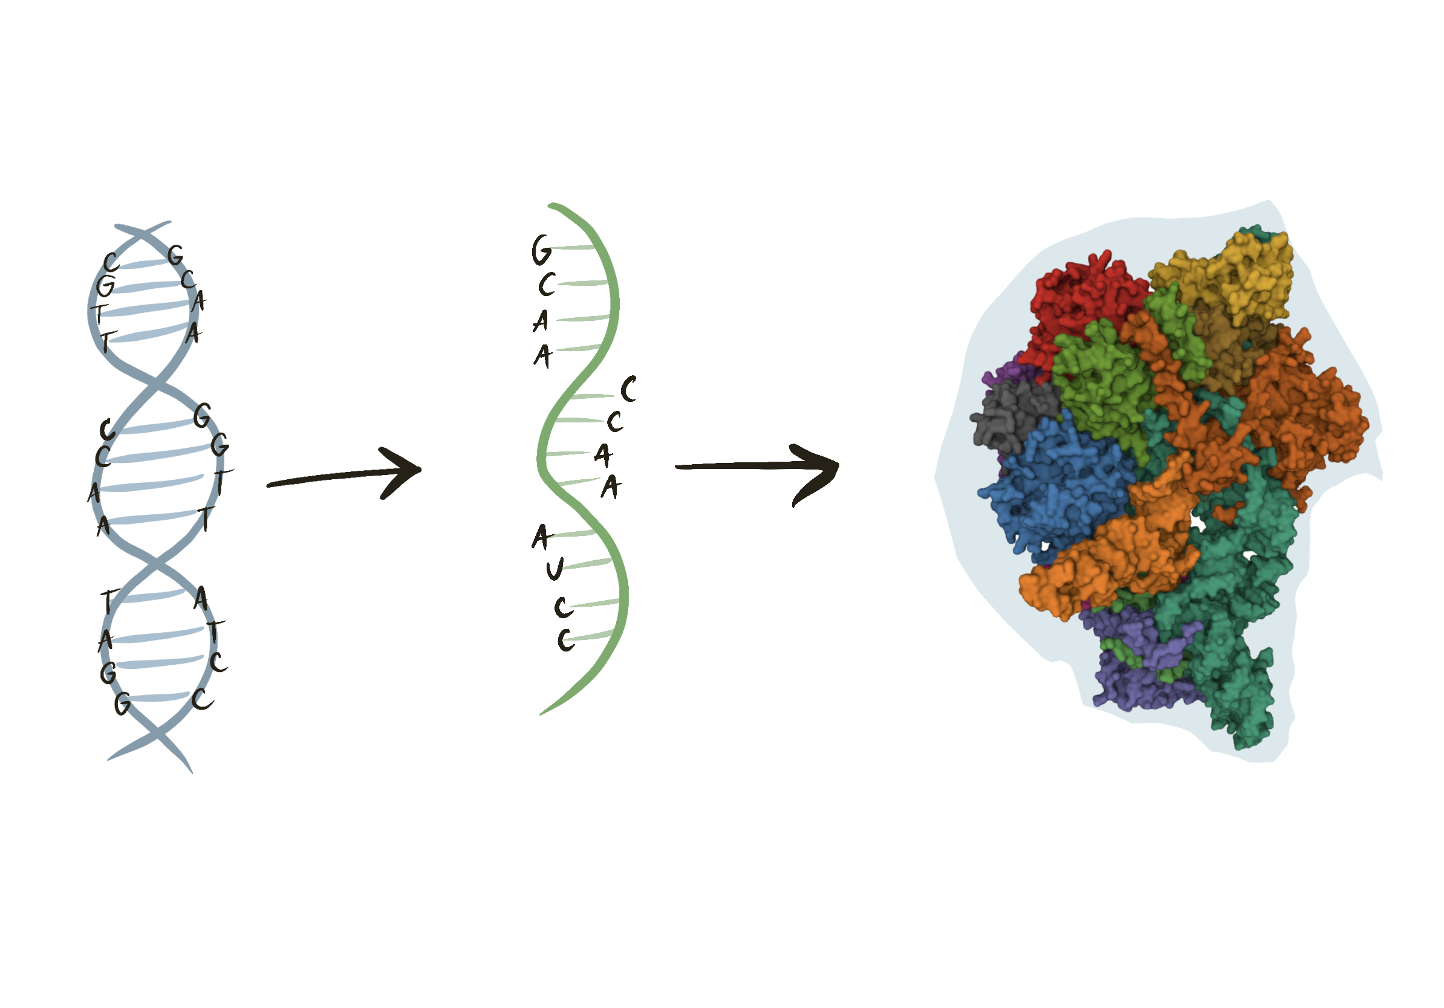
From plan to product
doi: 10.1093/nar/gkab314

Slide 14

How is information stored in DNA?

Slide 15

How is information stored in DNA?
C
G
C
G
T
A
Order of bases (A, T, G, C)
The genetic code is universal
T
A
T
A
G
C

Slide 16
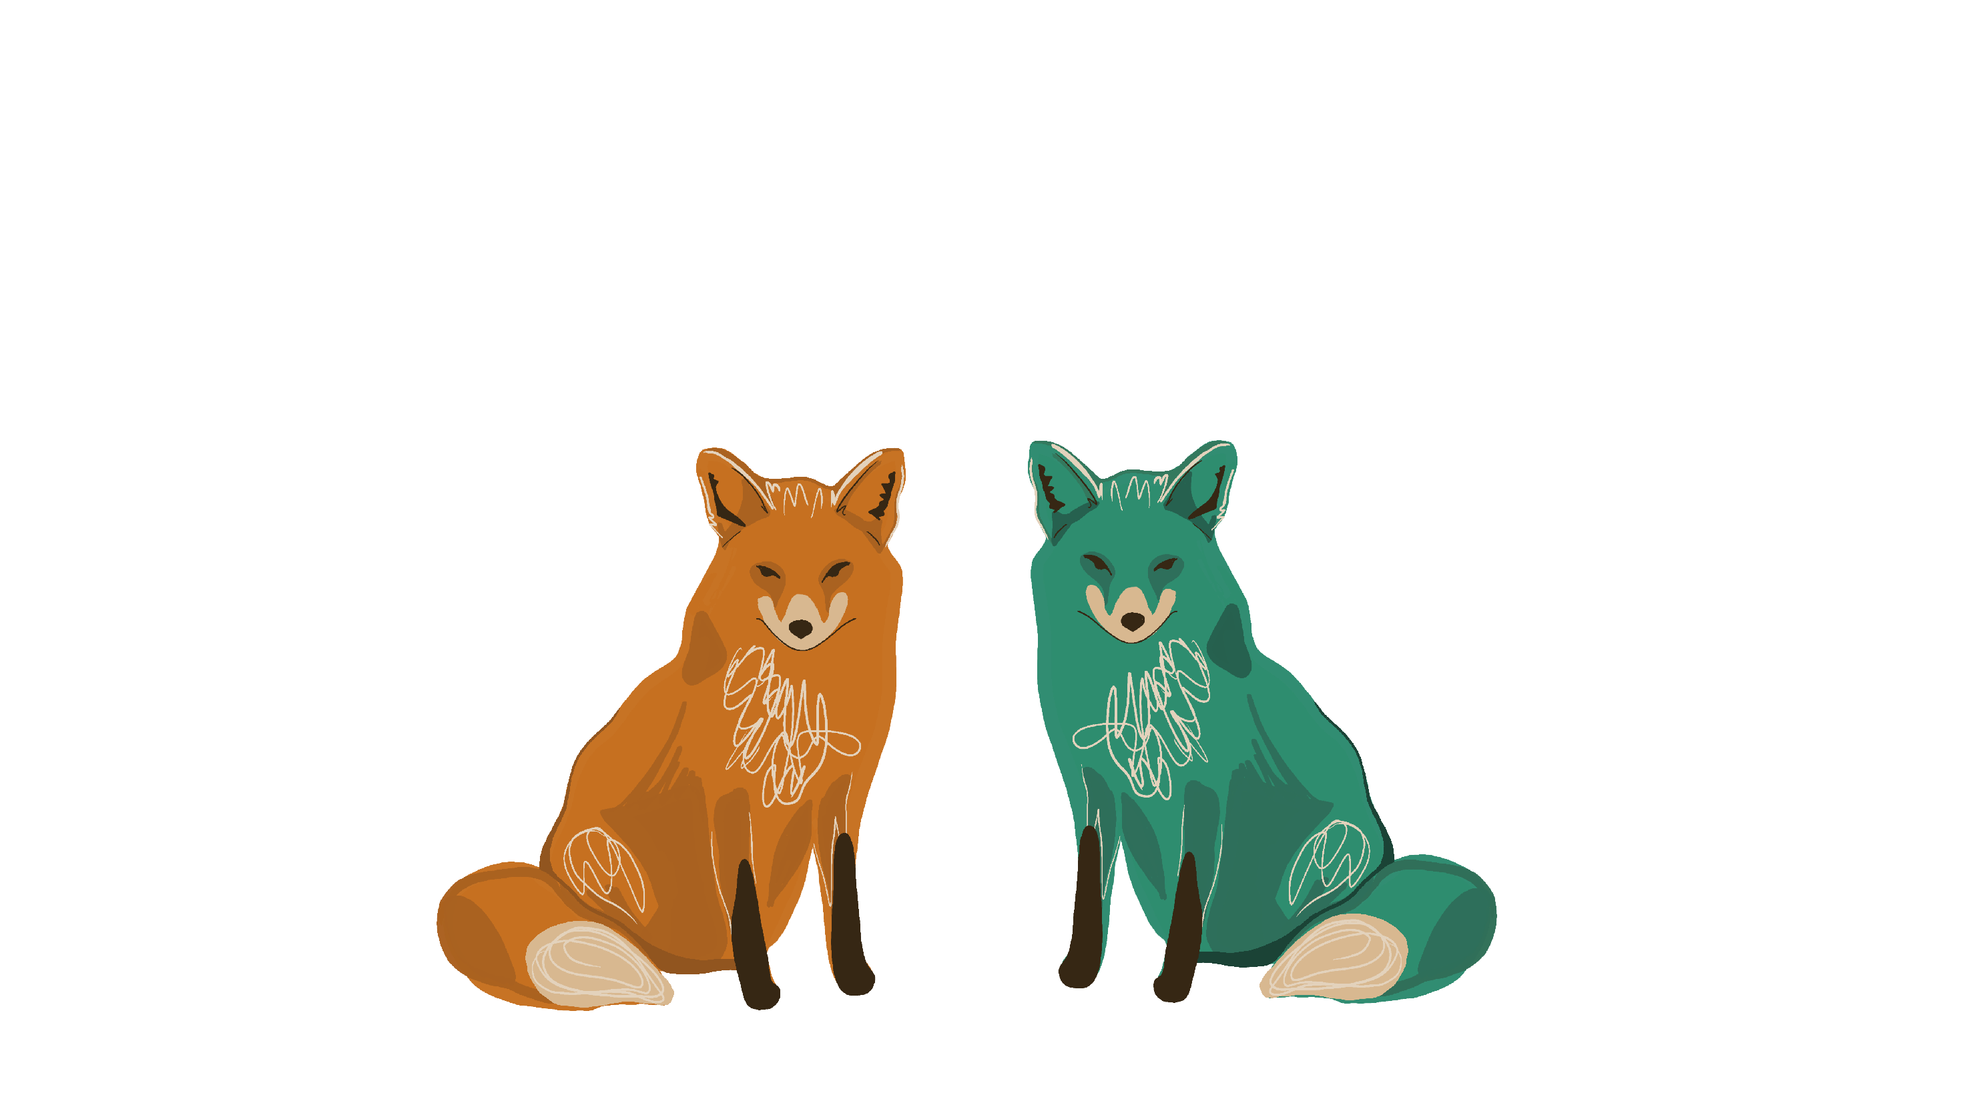
How do we work with genes?

Slide 17

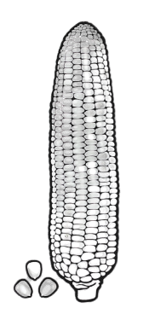


Slide 18
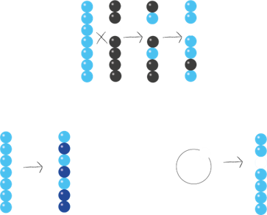

Breeding
targeted, time-consuming
Induced mutagenesis
Genetic modification
random, quick
targeted, quick

Slide 19
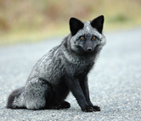
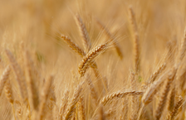
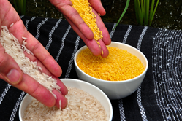
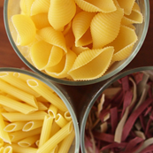
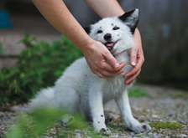
Breeding
Induced mutagenesis
Genetic modification
Golden rice
Domestication of the silver fox
Durum wheat (semolina)

Slide 20
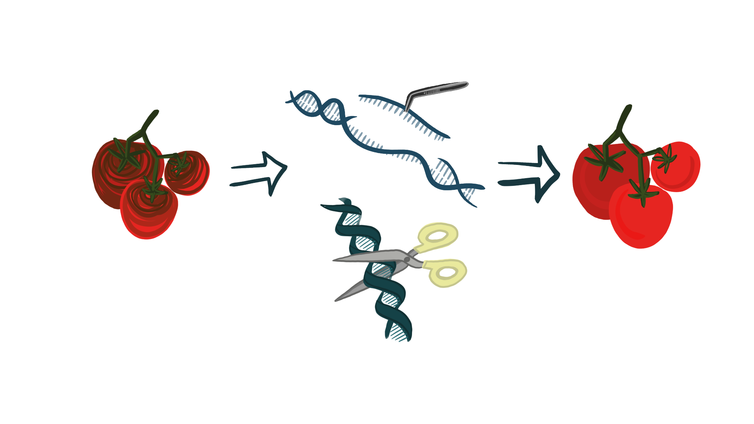
Gene manipulations in practice

Slide 21
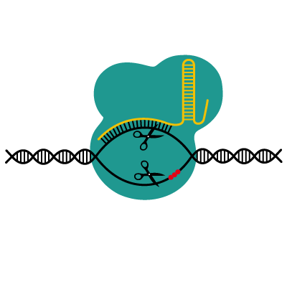
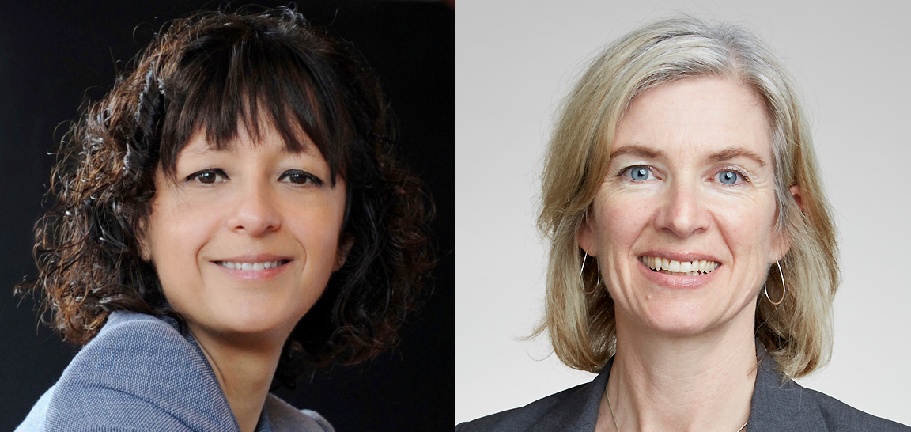
CRISPR/Cas = genetic scissors
Nobel Prize 2020 - Jennifer Doudna, Emmanuelle Charpentier
Should it be subject to the same regulations as GMOs?
Notes:
Přesně najít a nahradit,
Odstranění, výměna, vypnutí genu

Slide 22
Transgenesis
We isolate a helix of DNA from the cells of organism A
Using specific enzymes, we cut out the gene we want
Using another enzyme, we insert this gene into the vector
Insert the vector into the cells of organism B
Organism B starts to produce the new protein of our choice
Organism B displays the specific desired feature
Notes:
Přidat přirovnání s letadlem a GPS

Slide 23
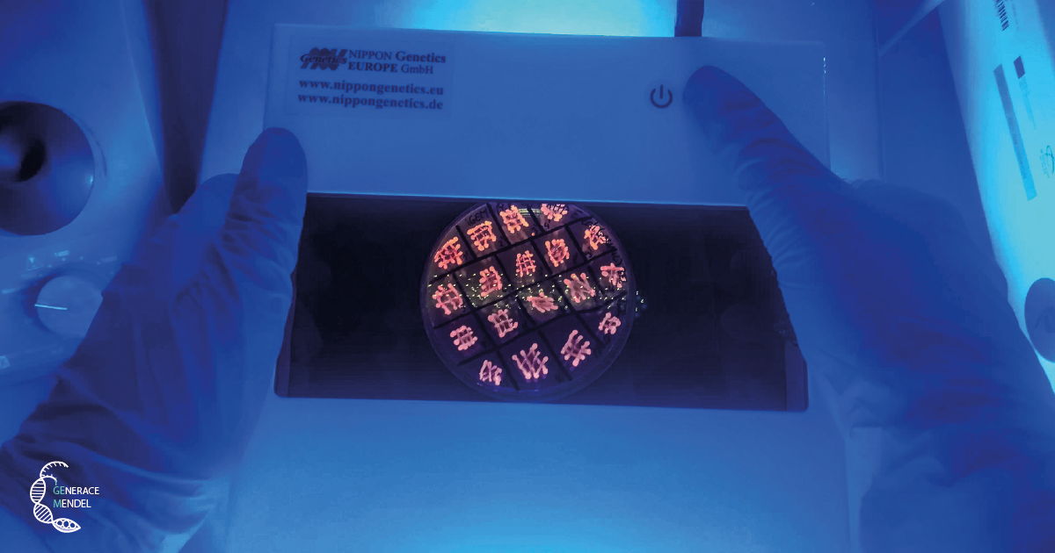
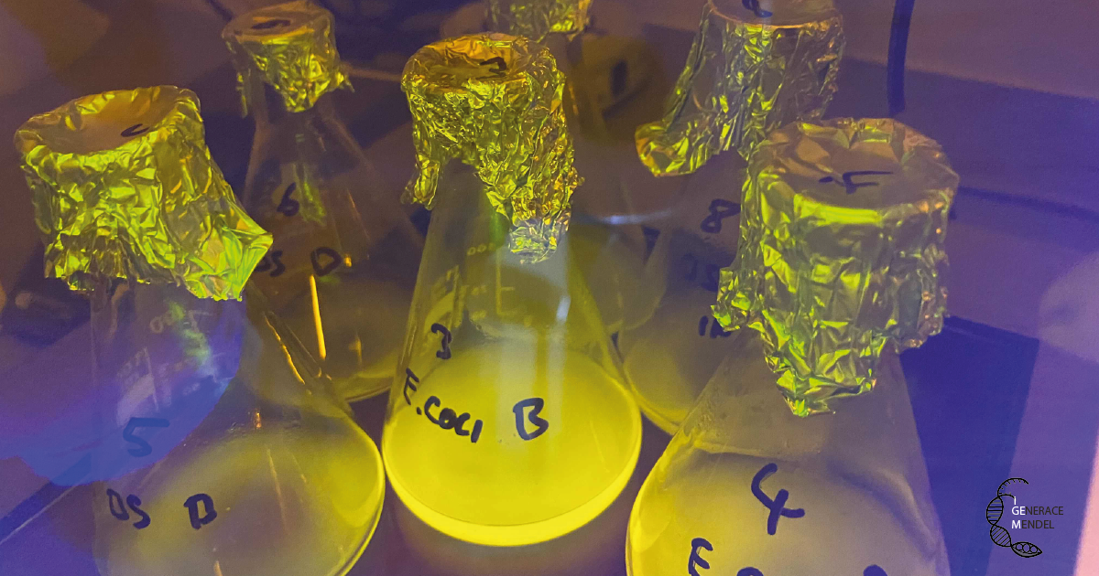
And this is what it looks like in reality

Slide 24
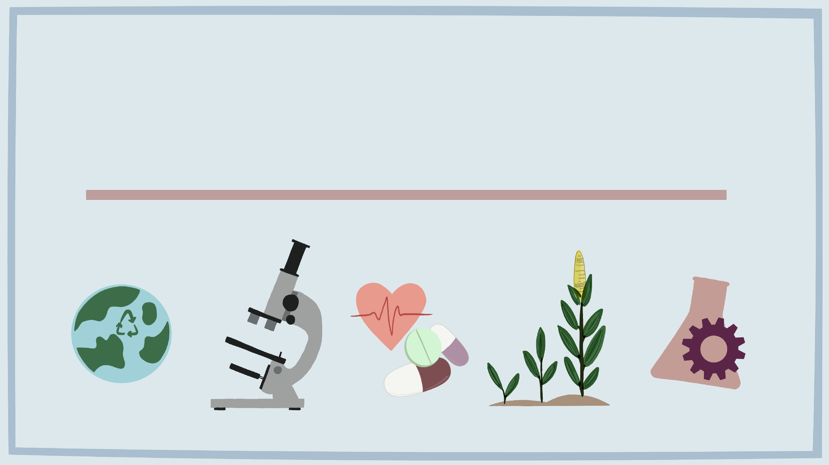
Application of GMOs
Application of GMOs

Slide 25

Research
Understanding how DNA works
A new tool for problem solving
The risks of bioerrorism and bioterrorism
Biological weapons
- Resurrecting eradicated diseases

Slide 26
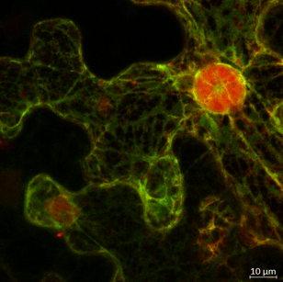
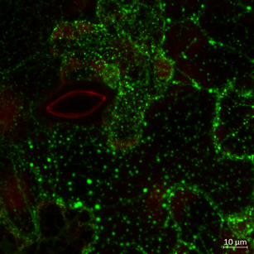
GFP or why we light up organisms
GFP - a small, easily detectable, non-toxic protein.
Determines how and where other proteins form
Reveals interactions between proteins
Can track cancer
Notes:
Neocenitelný zdroj informací

Slide 27
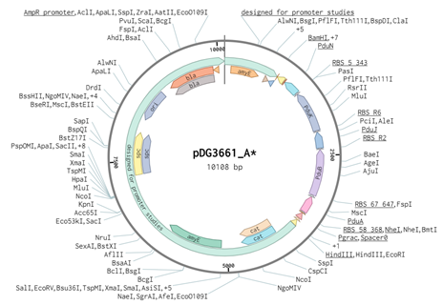
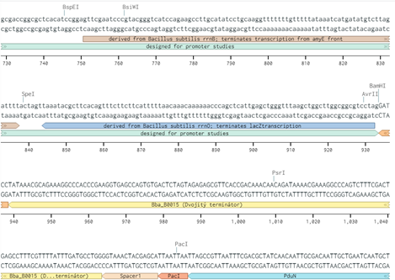
How do we design DNA?

Slide 28

Medicine
Easy to obtain high purity pharmaceuticals
Treatment of the cause (hereditary diseases, gene therapy)
New approaches and options for the treatment of incurable diseases
Ethically problematic
Where is the line?

Slide 29
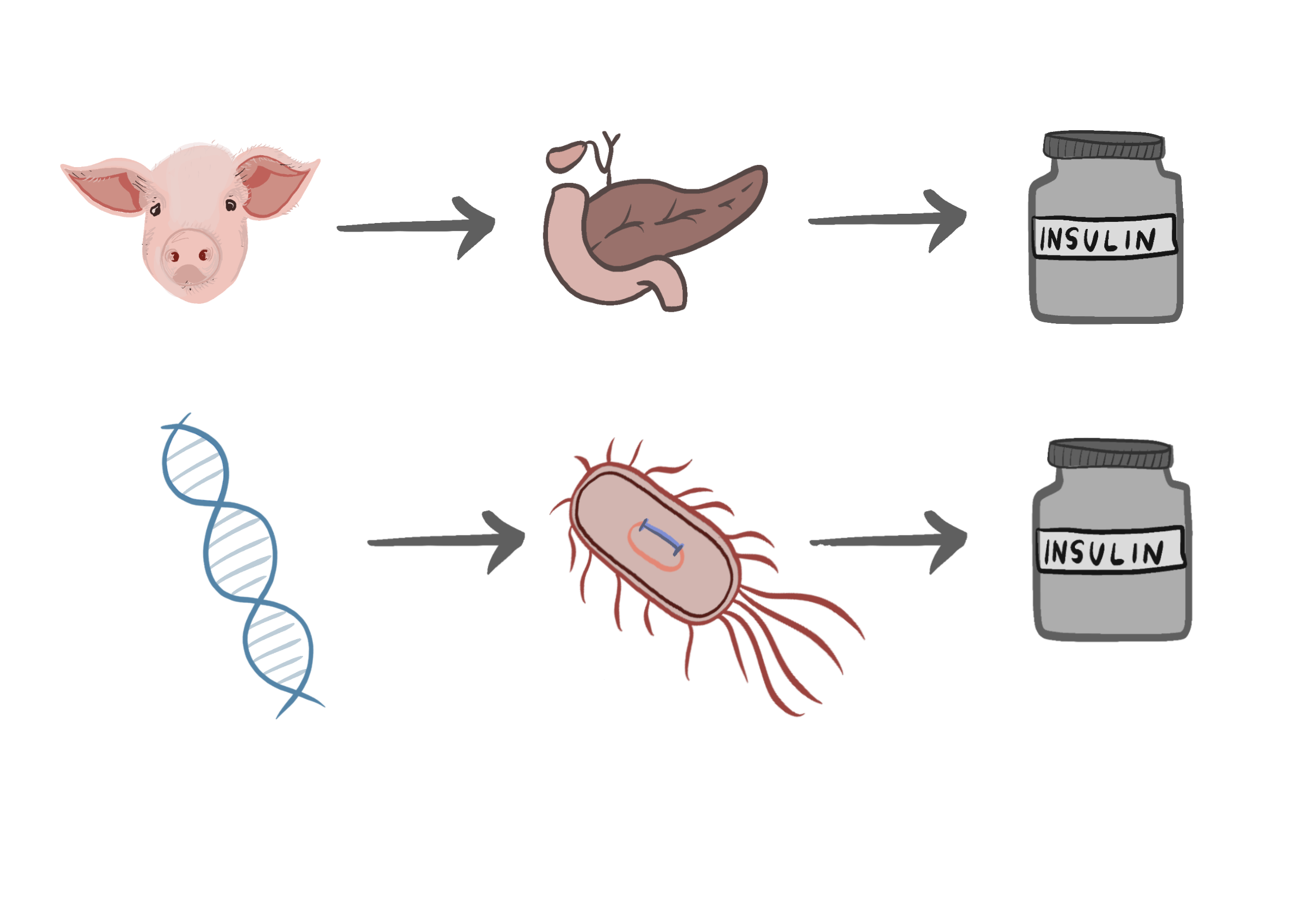
Insulin
Pancreatic hormone
Blood glucose regulation
Treatment of diabetes mellitus
Production by GMOs
since the 1980s

Slide 30
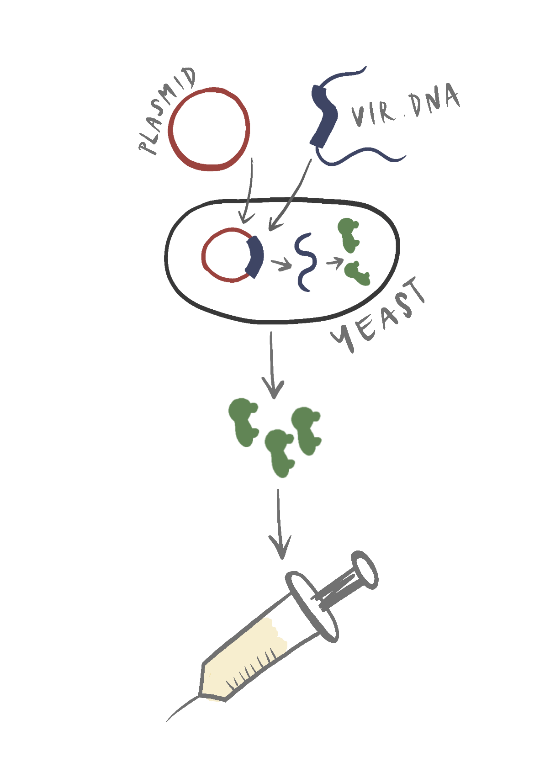
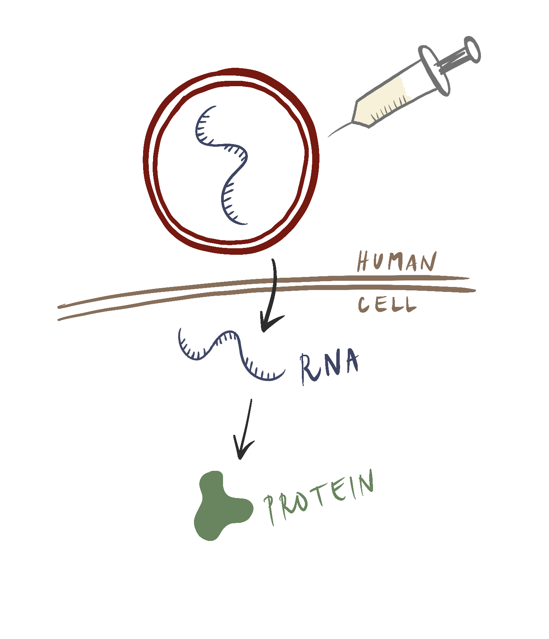
Recombinant and gene vaccines
Recombinant: Hepatitis B
Genes: Covid-19

Slide 31
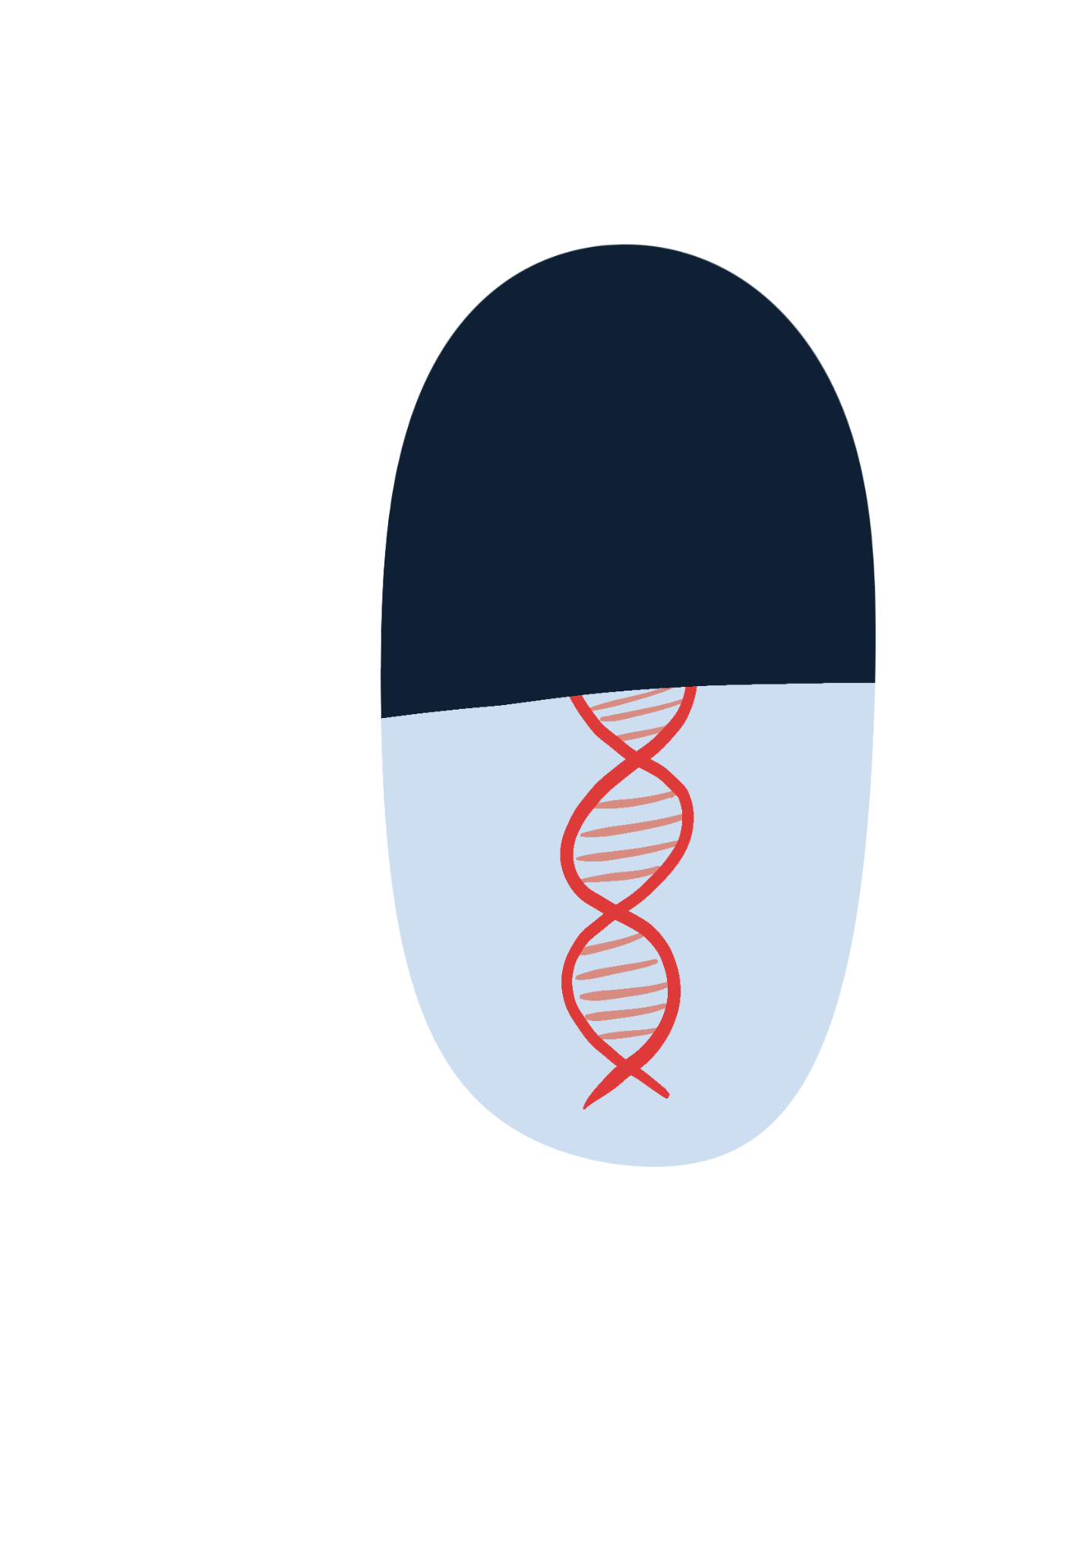
Gene therapy
Replacing a mutant version of a gene with a healthy gene
Hereditary loss of vision
B lymphoma - a type of cancer
White blood cell training
Notes:
zjednodušit to jen na B lymfom
úprava bílých krvinek pacienta pro zacílení na nádorové buňky
přidání zdravé kopie, nebo oprava poškozené, ale i nepřímá: viz bílé krvinky s receptorem pro vychytání nádorových buňek

Slide 32
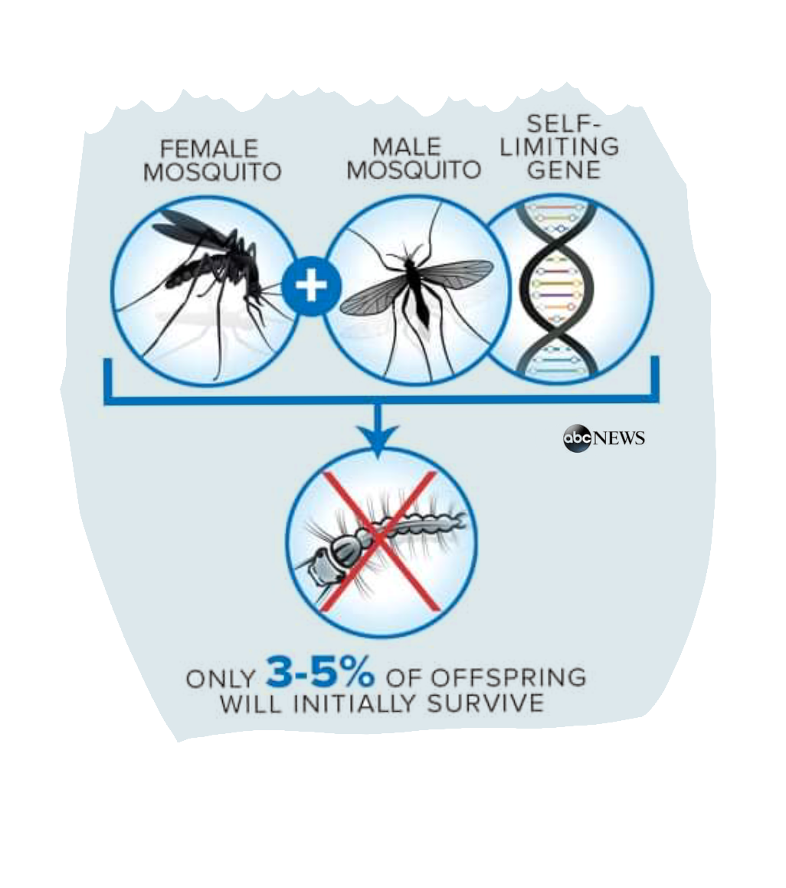
GM mosquitos
Mosquitoes transmit serious diseases
GMO → self-limiting gene
60% reduction in mosquito numbers
Organic, chemical methods didn't work
Specific to the selected mosquito species
Notes:
https://edition.cnn.com/2021/04/30/health/genetically-modified-mosquitoes-us-scn-wellness/index.html
https://time.com/6047051/genetically-modified-mosquitoes/
https://undark.org/2021/04/12/gmo-mosquitoes-to-be-released-florida-keys/

Slide 33
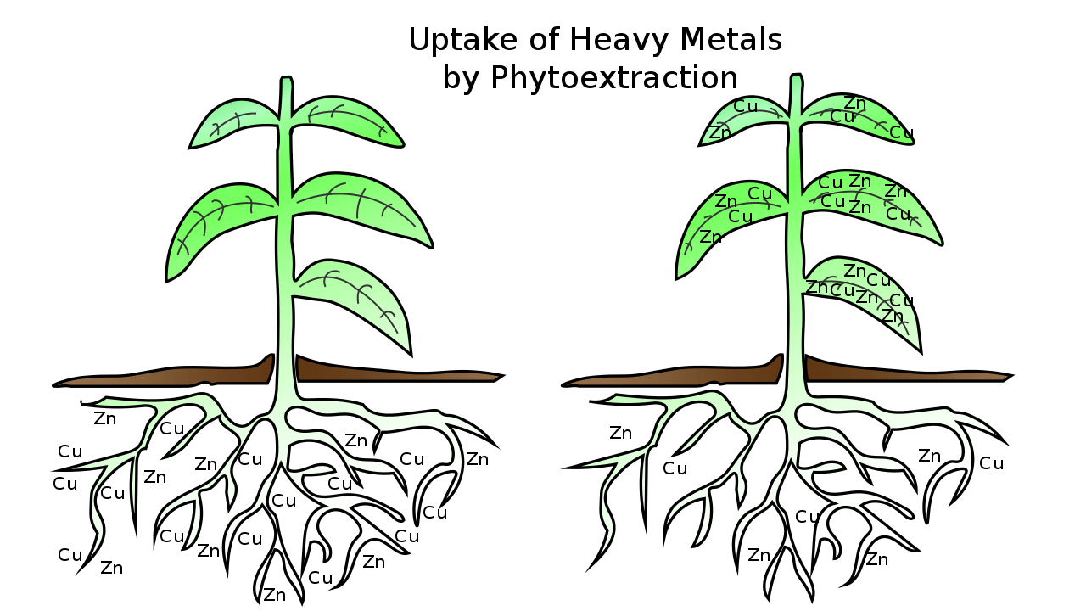
Phytoremediation
Removing pollutants from soil with plants
Genes for tolerance to heavy metals
Accumulation by plant
Burning plants under filters

Slide 34

Agriculture
Increase yield and nutritional value
More resilient crops and animals
Reduced pesticide use
Socio-economic problems
Increase in herbicide use
Emergence of resistance
Monocultures

Slide 35
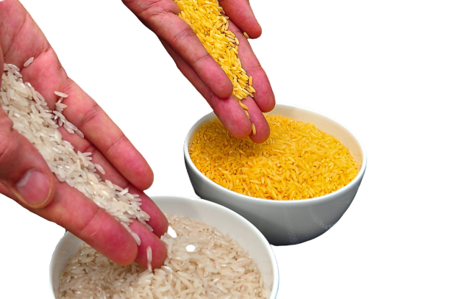
GOLDEN RICE
Hypovitaminosis leads
→ leading to blindness to blindness
Enrichment with B-carotene
→ (provitamin A)
2021 approved in the Philippines

Slide 36
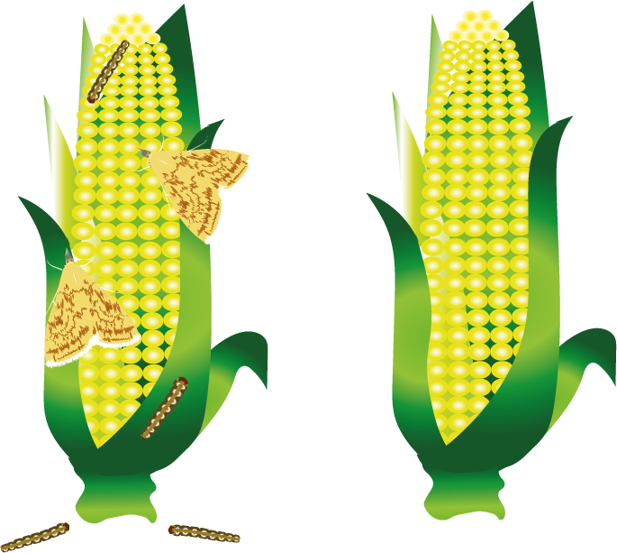
BT CORN
Resistance to caterpillars
corn earworm
Species-specific production
toxic protein
Authorised in the EU
Reduction of pesticide use
Less mycotoxins
Notes:
https://www.mzp.cz/cz/aktualni_informace
https://www.mzp.cz/C1257458002F0DC7/cz/aktualni_informace/$FILE/OERES-plocha_MON810-20210616.pdf - pěstování BT kukučice v Čr
https://ekolist.cz/cz/zpravodajstvi/zpravy/v-cr-se-letos-nebude-pestovat-geneticky-modifikovana-kukurice - hlavní důvod proč se již nepěstuje byl nižší zájem odběratelů a birokratická zátěž na pěstování

Slide 37

HERBICIDE TOLERANT PLANTS
Herbicide x total herbicide
Glyphosate - Roundup
Built-in gene that makes the plant resistant
Increase in herbicide use

Slide 38
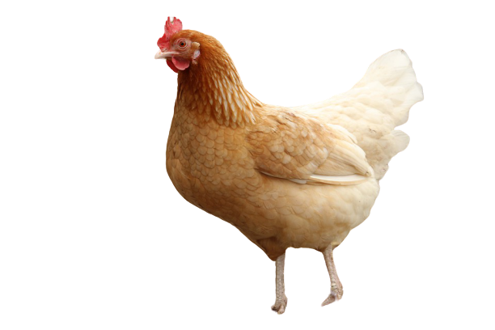
GENETICALLY MODIFIED HEN
Czech idea
Resistance to avian leukosis virus
Changing a single amino acid
I´m Zora!

Slide 39

Biotechnologies and industry
Production of biological materials
Products not chemically produced
Higher yields, lower price
Utilisation of waste materials
High input costs

Slide 40
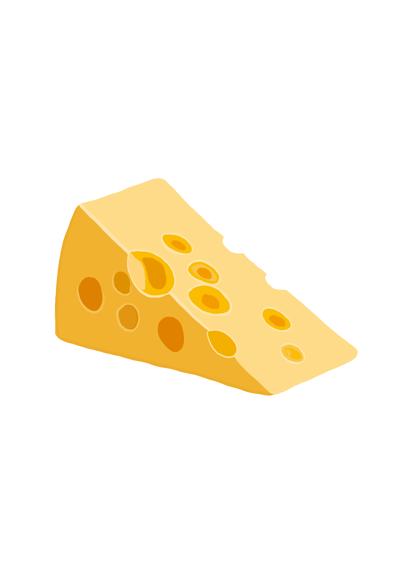
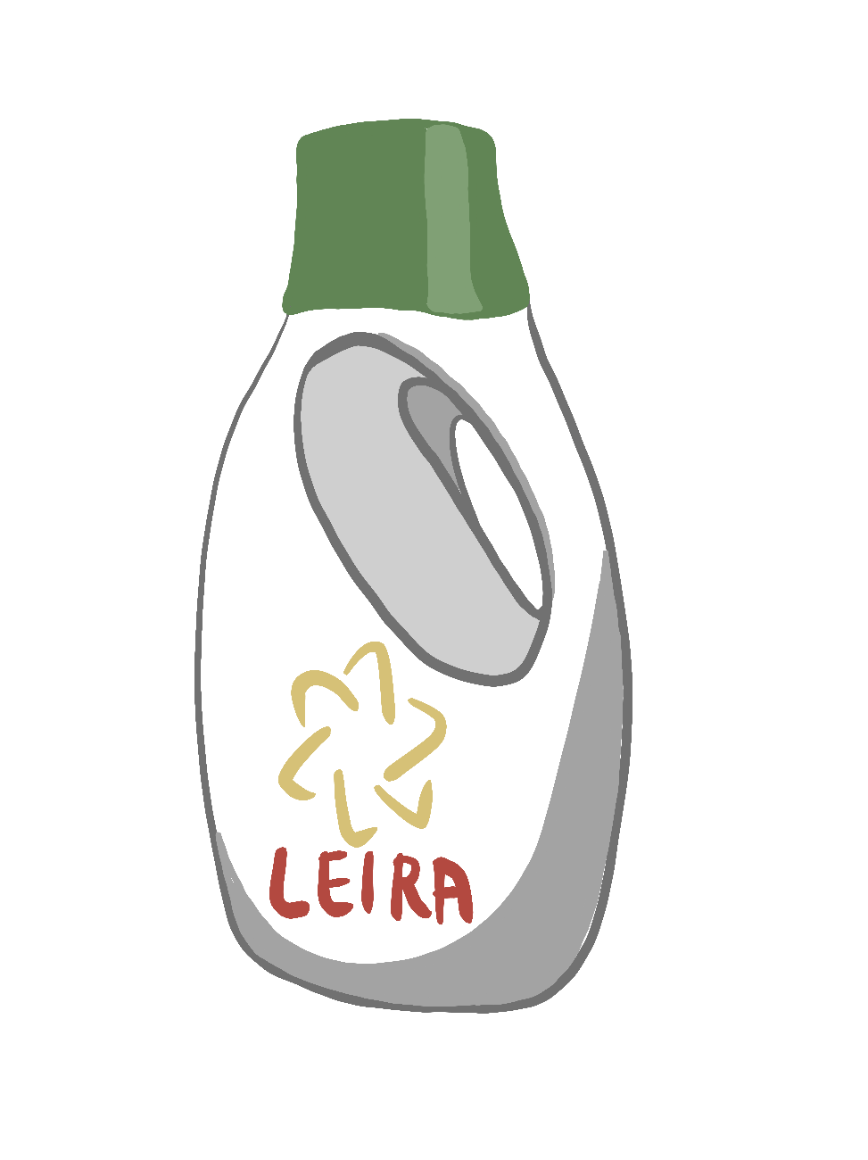
Use of enzymes
Enzyme: a protein that speeds up a chemical reaction
Detergents: proteases, lipases, amylases,
Cheese production (rennet)
Drugs and nutritional supplements

Slide 41
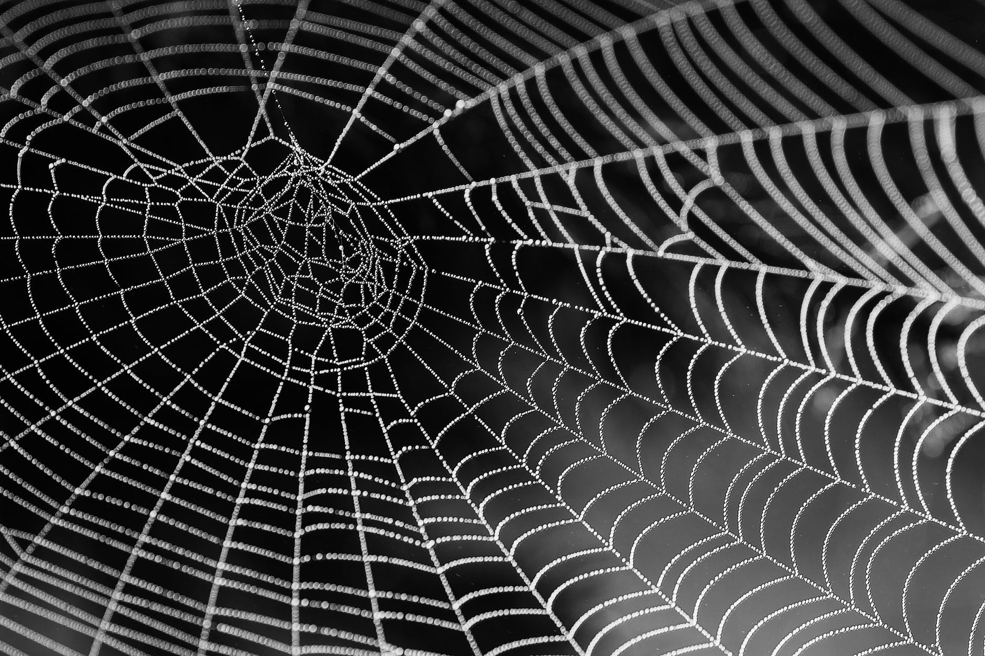
Spider silk fibers
Stronger than steel, lighter than synthetic fibres, elastic
Synthetic fabrics, bulletproof vests, bomb suits, airbags

Slide 42
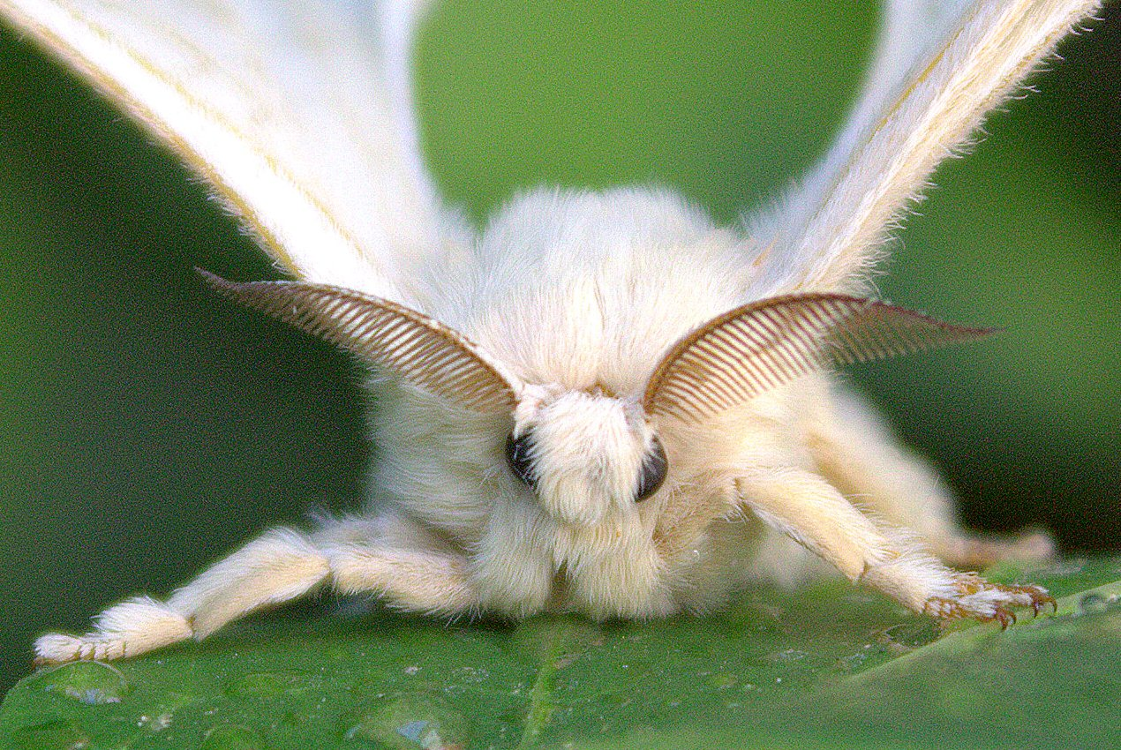
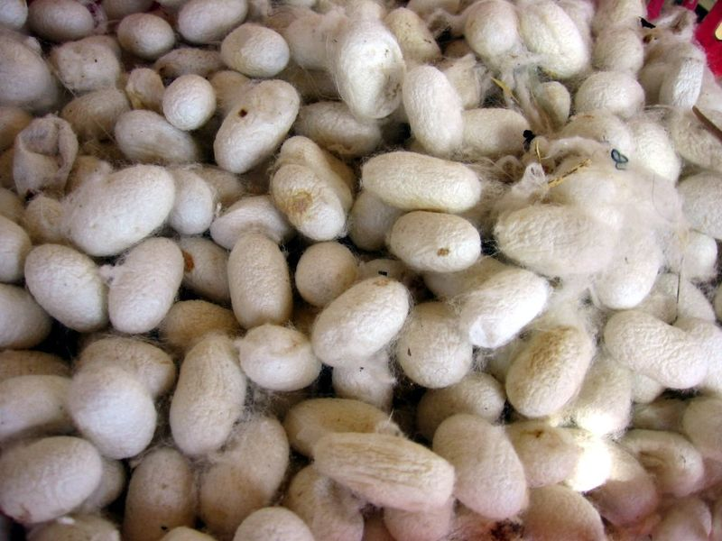
Spider silk fibers
silkworms, E. coli, goats

Slide 43
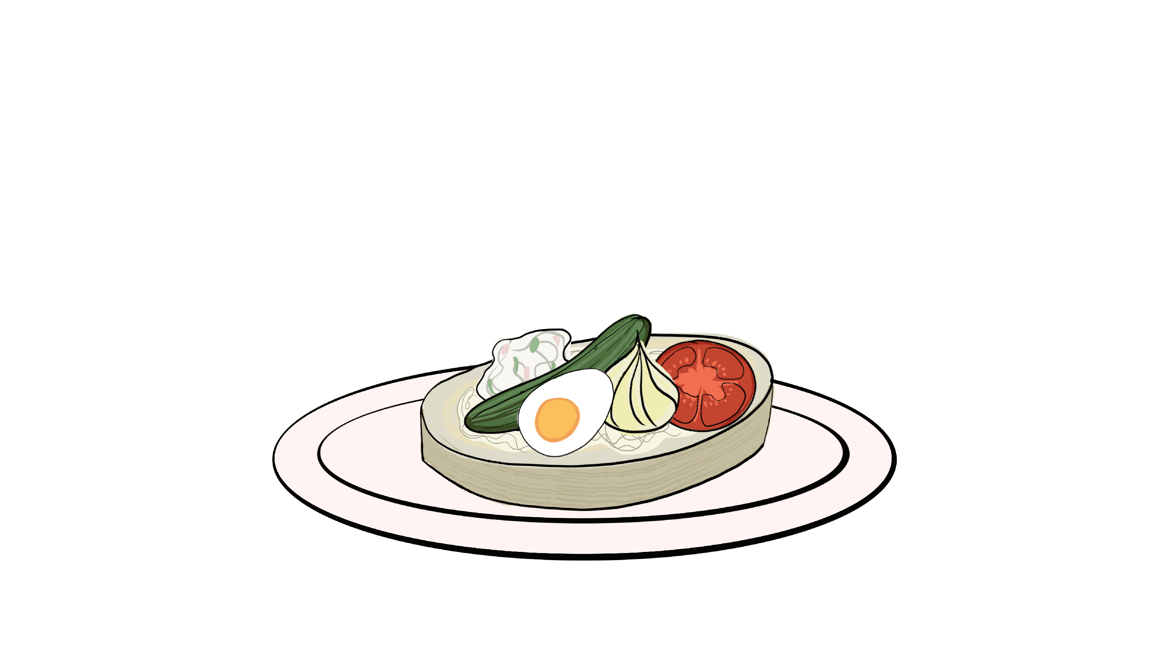
Break

Slide 44
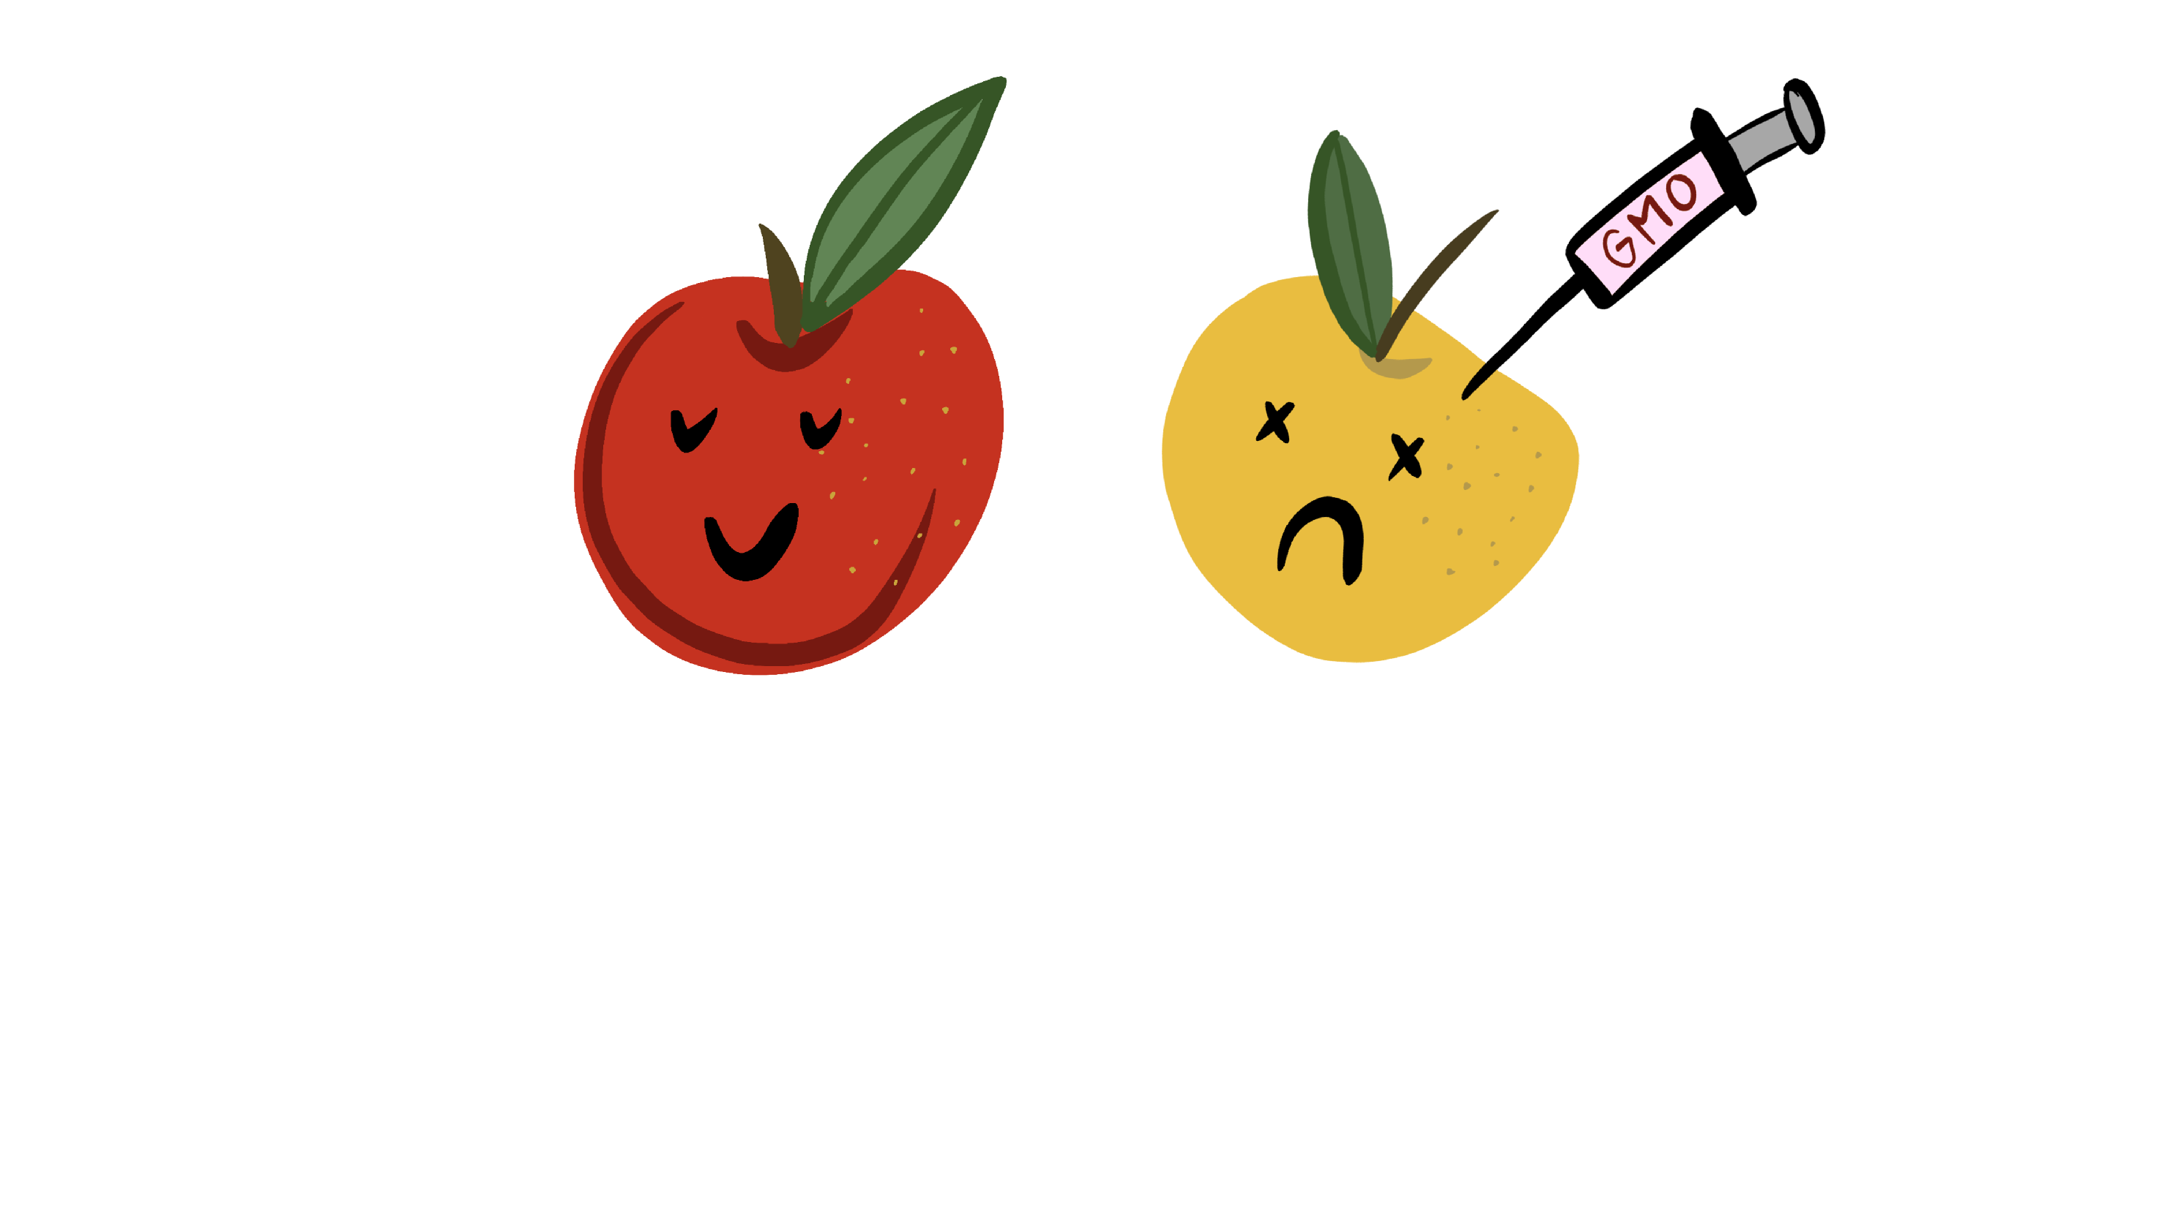
Myths and mystifications
Trust but verify…
Notes:
https://ct24.ceskatelevize.cz/veda/2709716-nepratele-geneticky-upravenych-potravin-vi-nejmene-o-genetice-o-vic-veri-svym-znalostem?fbclid=IwAR1rxTi9yLmsrTcfUM55QeQeLO0HSzYkjv7X6ko5TlOWGaJZt543reitMMQ

Slide 45
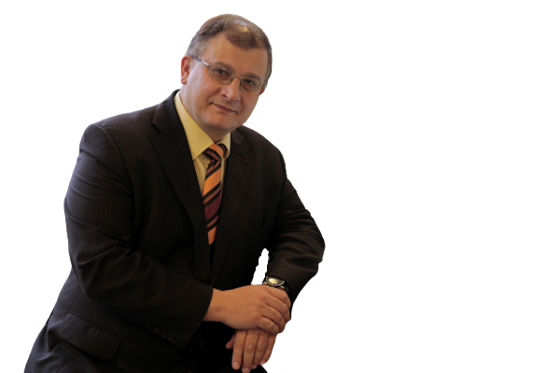
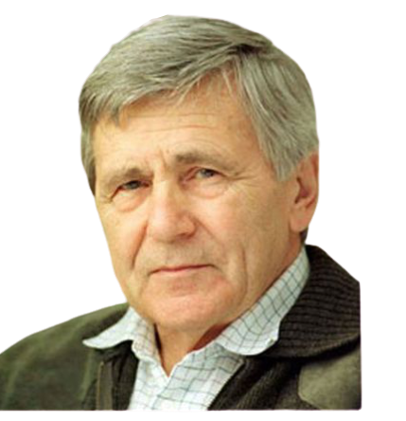
Árpád Pusztai andGilles-Eric Séralini
Studie o GM potravinách poukazující na zdravotní komplikace
Odmítnuto vědeckou komunitou
problémový design experimentu,
statistická analýza,
nevhodná volba linie
Nelze zobecnit výsledky
na všechny GM potraviny

Slide 46


Slide 47




Anti-GMO kampaň
Notes:
Stop a rajče jsou lcc
Frankenfood jsem nenašla alternativu
Býka se pokusím, ale u těch mystifikací se to dělá těžko.

Slide 48

WHAT IS OFTEN HEARD IN CONNECTION WITH GMO?
Can DNA from GM foods alter the DNA of the consumer?
Do GM foods cause allergies or cancer?
Will GMOs displace current species?
(escaping from labs, seeding fields, releasing into the wild)
Do we have enough experience with GMOs?

Slide 49


158 Nobel laureates sign the appeal
, to stop their anti-GMO campaign

Slide 50



Legislative

Slide 51


EU vs. USA
Closed/open GMO management
Emphasis on method/output
USA - use of existing laws

Slide 52

EU legislation
Directive 2001/18/EC on the release into the environment and placing on the market
Transgenesis vs. mutagenesis
Approval process
Environmental Risk Assessment
State, public views

Slide 53

Transgenesis
Application 2001/18
Amended 2015/412 - possibility of a GMO ban by a specific country
Also e.g. 1829/2003 and 1830/2003
Approval of GMO food and feed
Labelling of products
Coexistence rules for plants
No major changes can be expected, unlike mutagenesis

Slide 54

Mutagenesis
Exemption under Article 3, Annex I-B
Unclear until 2018
Judgment CJEU C-528/16
Mutagenesis techniques after 2001 = prohibition
The Council invited the Commission to evaluate the current regulation of GMOs

Slide 55


Future

Slide 56

Terraformation of Mars
Creating the atmosphere - the most important step
GM Oxygen-producing cyanobacteria
Space synthetic biology
Notes:
Genetické modifikace umožní přežít nehostinné podmínky

Slide 57

Luminescent plants
The whole plant and its roots shine
Luminescence observed with the naked eye
Street lighting?

Slide 58


Data storage
DNA → storage capacity with high precision
E. coli storage density = 10^19 bits per cm3
Annual global data storage consumption → DNA "cube" with 1 m edge
Notes:
86 Exabits (Ebit)

Slide 59

Our project: the phosphorus cycle

Slide 60
GENETIC MODIFICATIONS are a TOOL
2. individual GMOs can have a DIFFERENT NATURE.
Individual cases should be CONSIDERED INDEPENDENTLY OF EACH OTHER

