Slide 1
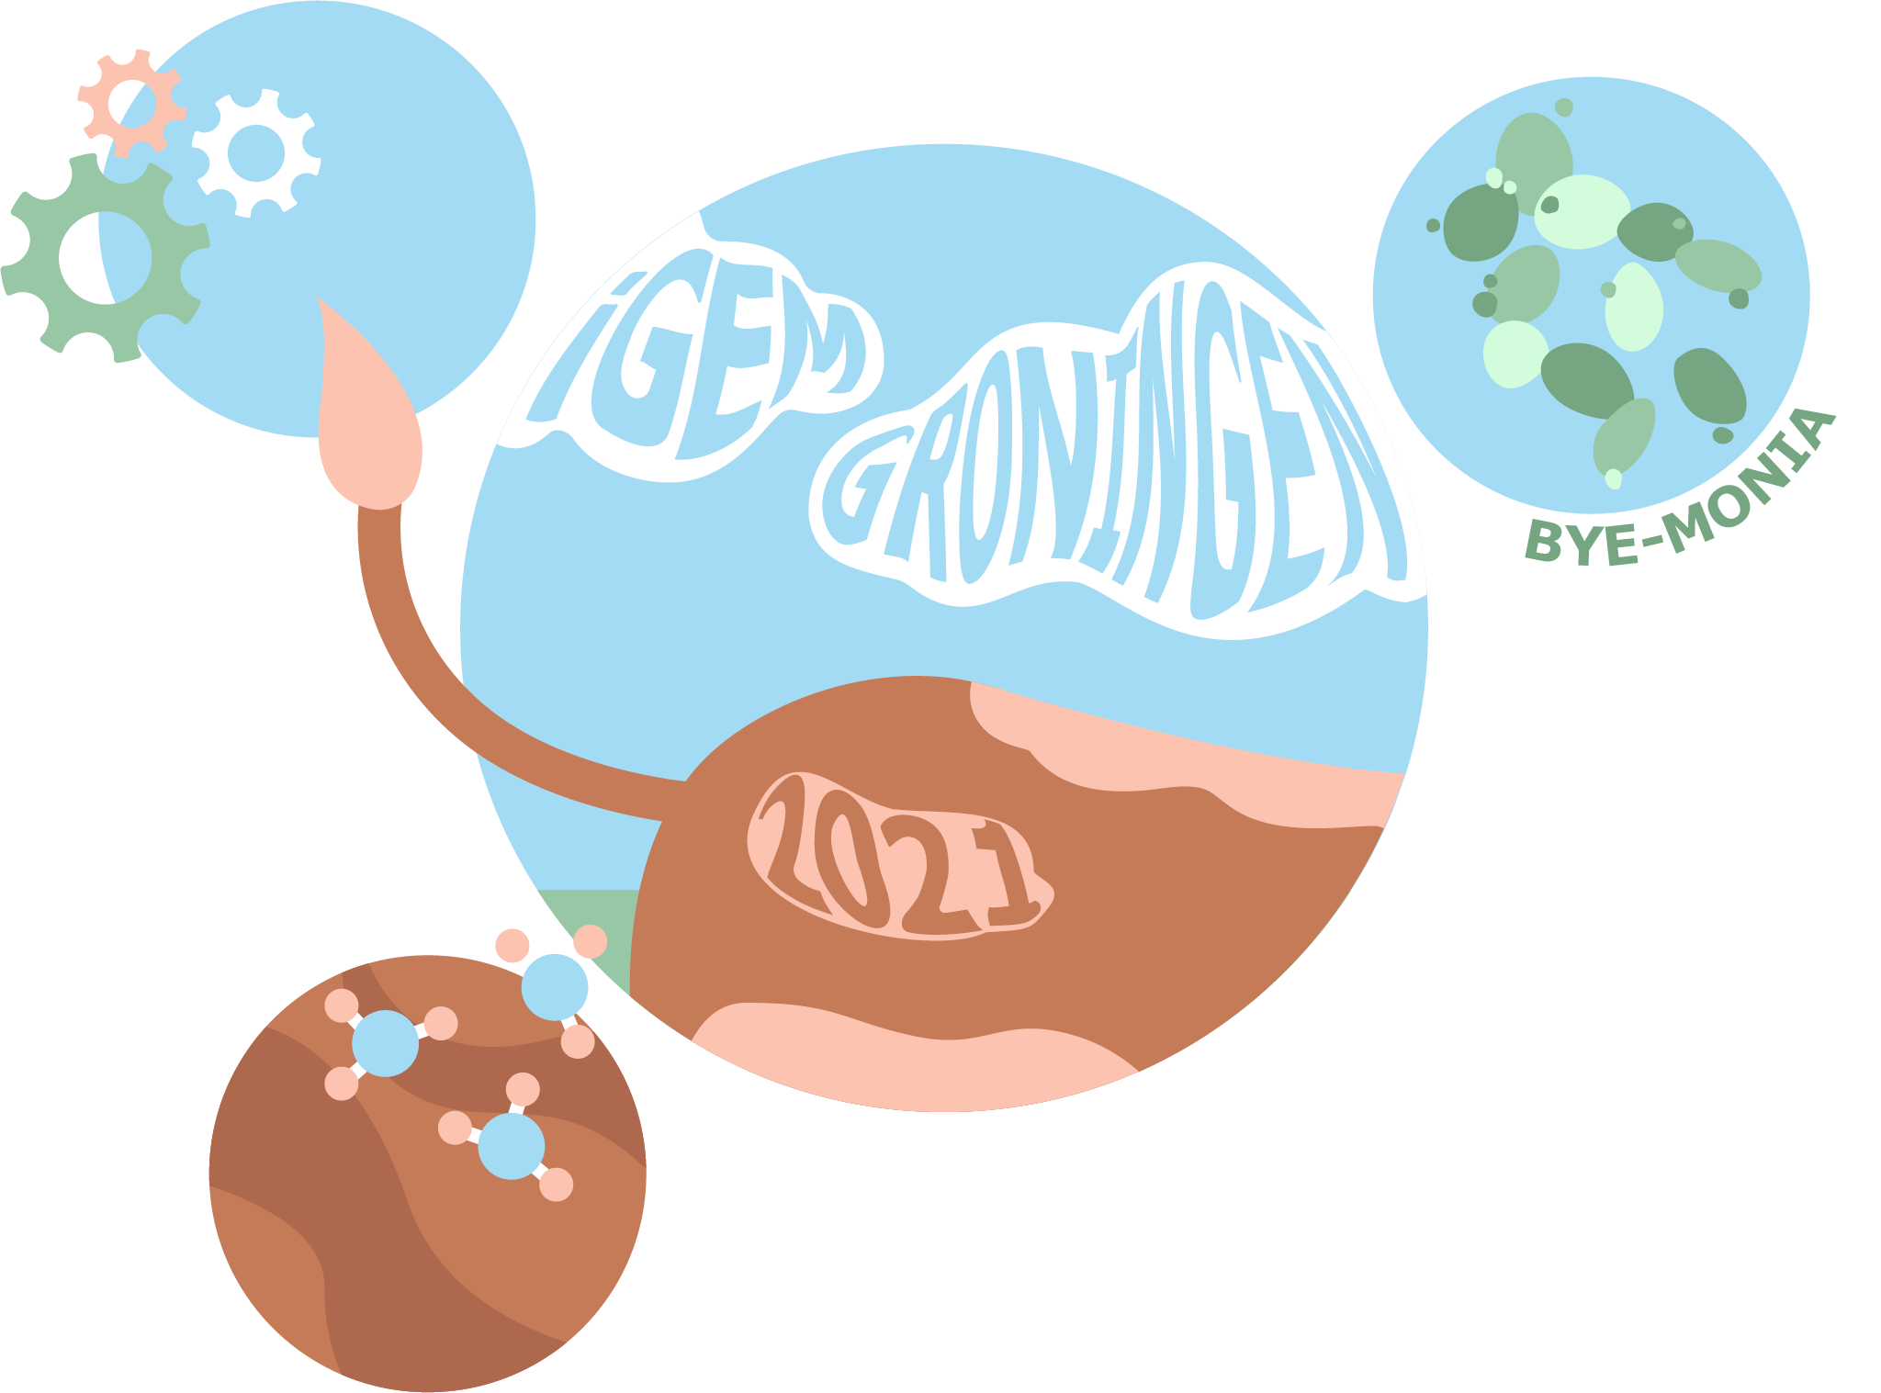
Bye-Monia
iGEM Groningen 2021
Stakeholder Meetup Simulation

Slide 2

Why are we doing this?
iGEM Wageningen 2021 developed guide for Stakeholder Meetup Simulation
Role playing stakeholder groups of your project
Meet up to learn about values, synergies, conflicts and solutions
Testing to improve guide
First explanation, then
role play (in groups)

Slide 3
Time table
Introduction (30 min)
  Why are we doing this?
  What is iGEM?
  What is the problem?
  What is our solution?
---- Break ----
Breakout rooms (15 min)
---- Break ----
Speech & rebuttal (10 min)
Conclusive discussion (10 min)

Slide 4
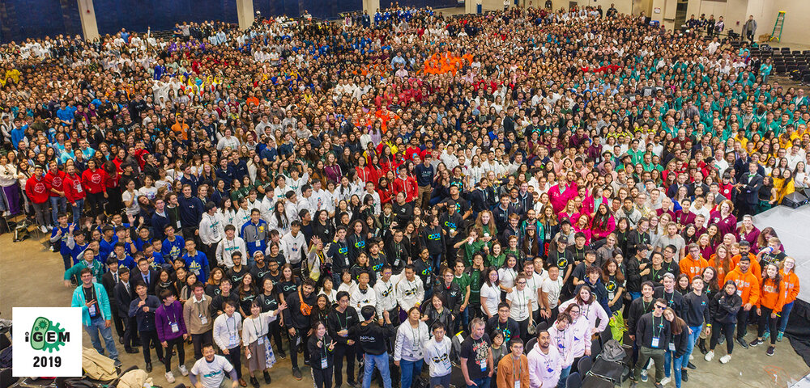
What is iGEM?
International Genetically Engineered Machine
Biggest competition within genetic modification in the world
+- 360 (student)teams all over the world

Slide 5

What is iGEM?
Solving real, local problems using synthetic biology
  Genetic modification for bacteria/fungi/yeast
  New abilities
  Production, sensors and more!
8 months to
  Think of a problem
  Think of a solution
  Design the solution
  Set up and run experiments
  Set up and run models
  Gather own funding
  Collaborate with other teams
  Talk to stakeholders
  Develop educational material
  Implement safety
  Build a website and make a video
iGEM as a “thinktank”

Slide 6
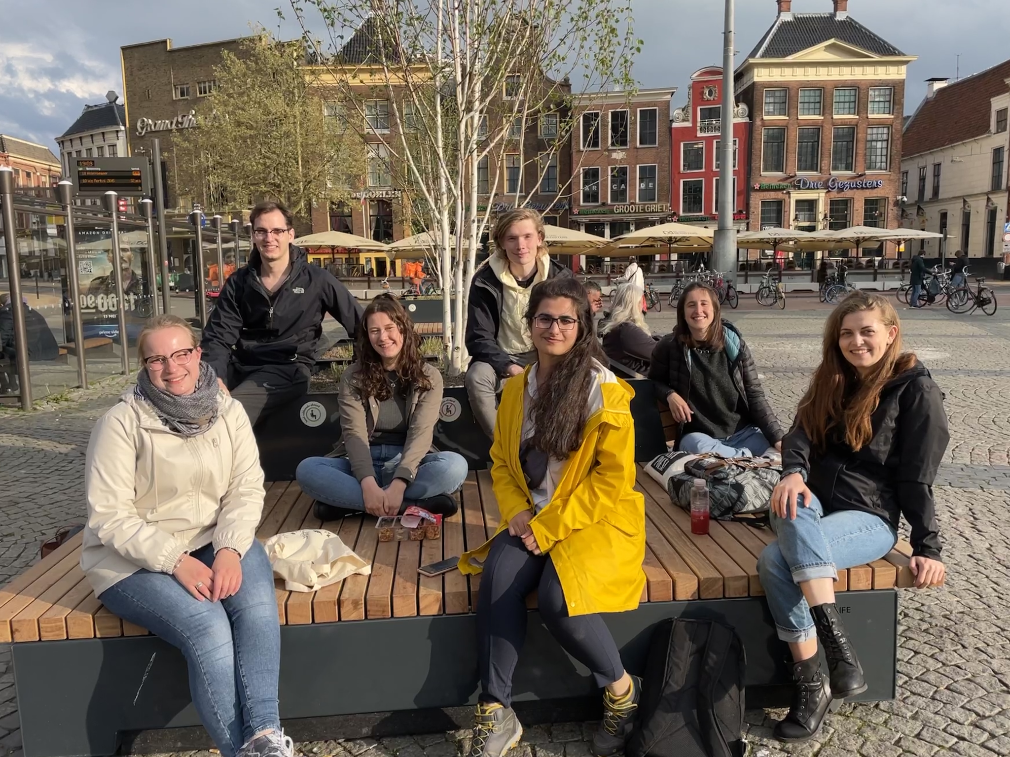
And this is where we come in!

Slide 7
The problem

Slide 8
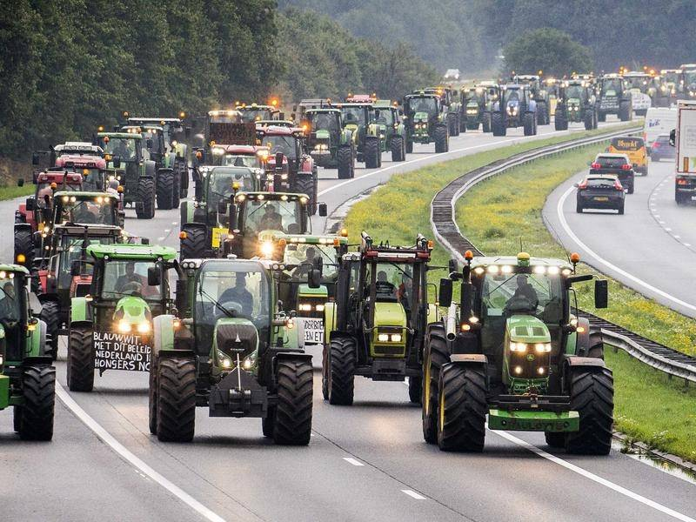
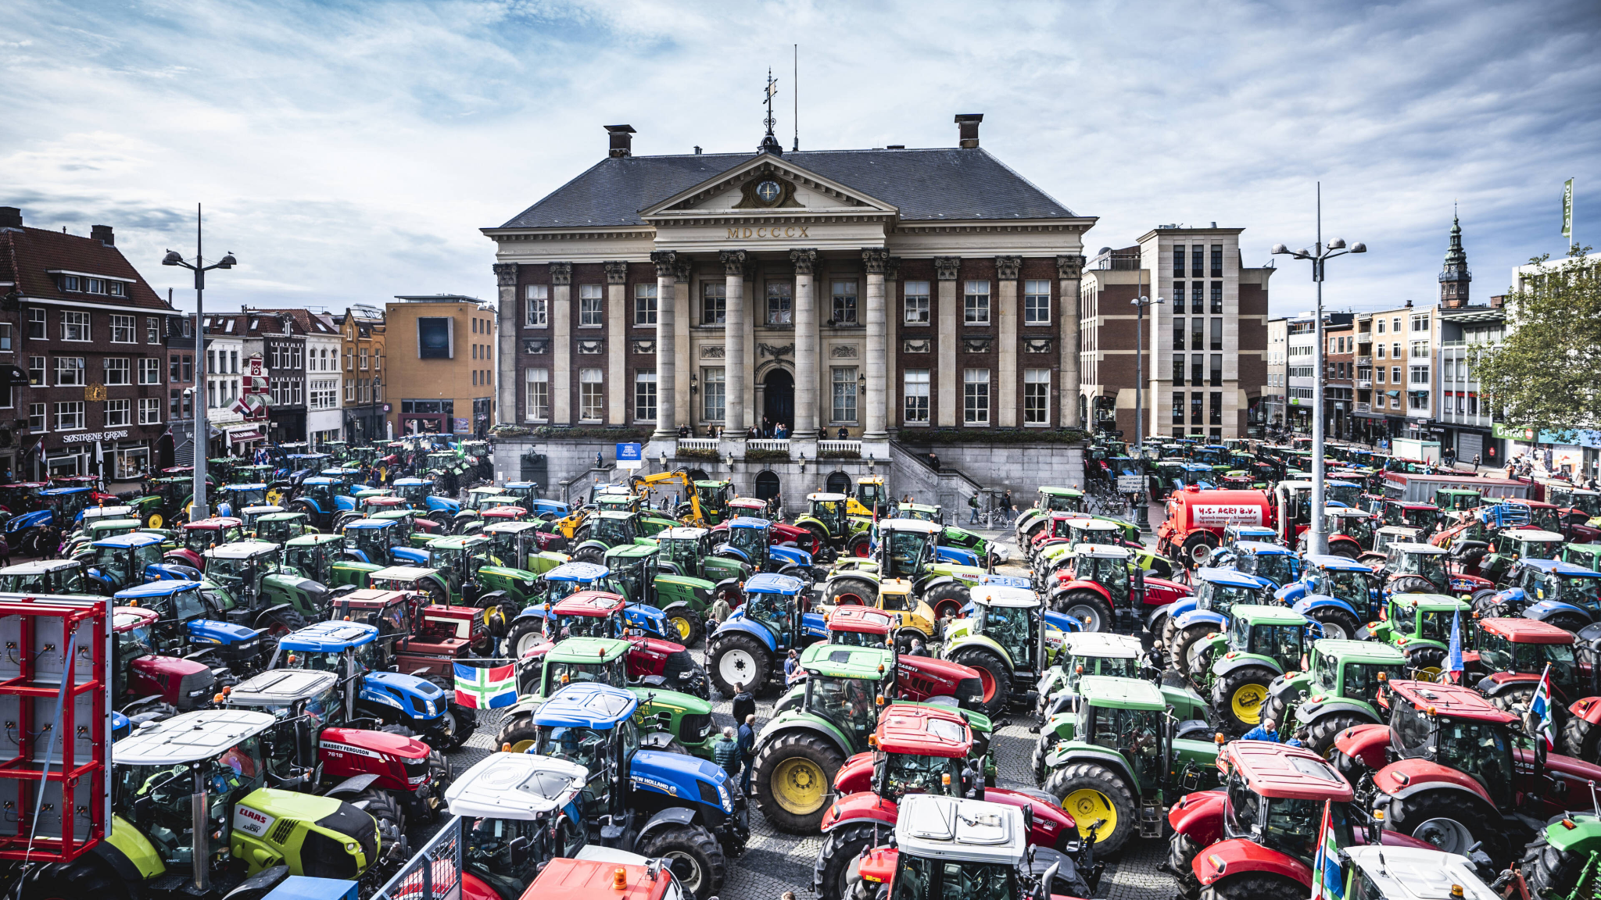
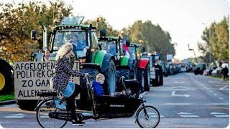
Nationwide farmers protests

Slide 9
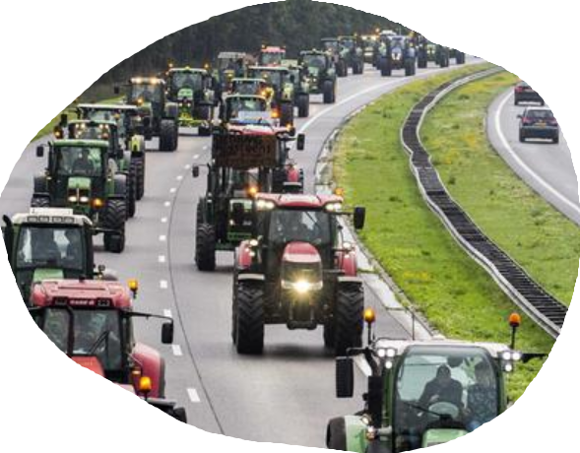
Nitrogen crisis
Nitrogen emissions by human activities are exceeding the tolerable levels. This threatens nature in Natura 2000 areas
70% of the countries surface area exceeds critical limits for nitrogen. The Dutch nitrogen surplus is 4x the EU average [1]
Ammonia emissions are a critical part of the issue.
National farmers protests arose as a result of decisions the Dutch government made to curb the nitrogen crisis
Notes:
[1] European Commission, “Commission recommendations for The Netherlands’ CAP strategic plan Accompanying the document COMMUNICATION FROM THE COMMISSION TO THE EUROPEAN PARLIAMENT, THE COUNCIL, THE EUROPEAN ECONOMIC AND SOCIAL COMMITTEE AND THE COMMITTEE OF THE REGIONS Recommendations to the Member States as regards their strategic plan for the Common Agricultural Policy,” Comm. staf Work. Doc., 2020.

Slide 10
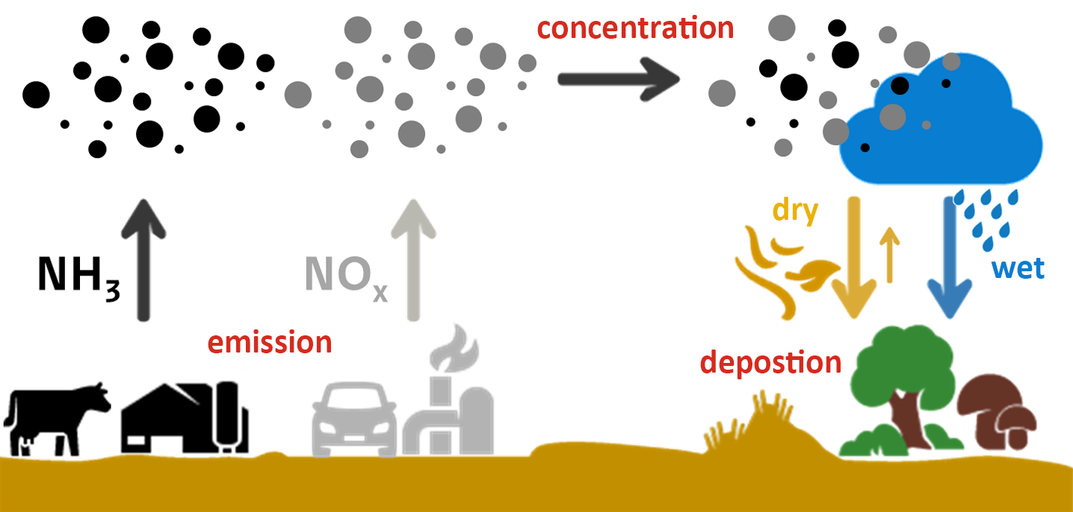
Nitrogen crisis: NOx and NH3

Slide 11
Nitrogen crisis: NOx and NH3

Slide 12

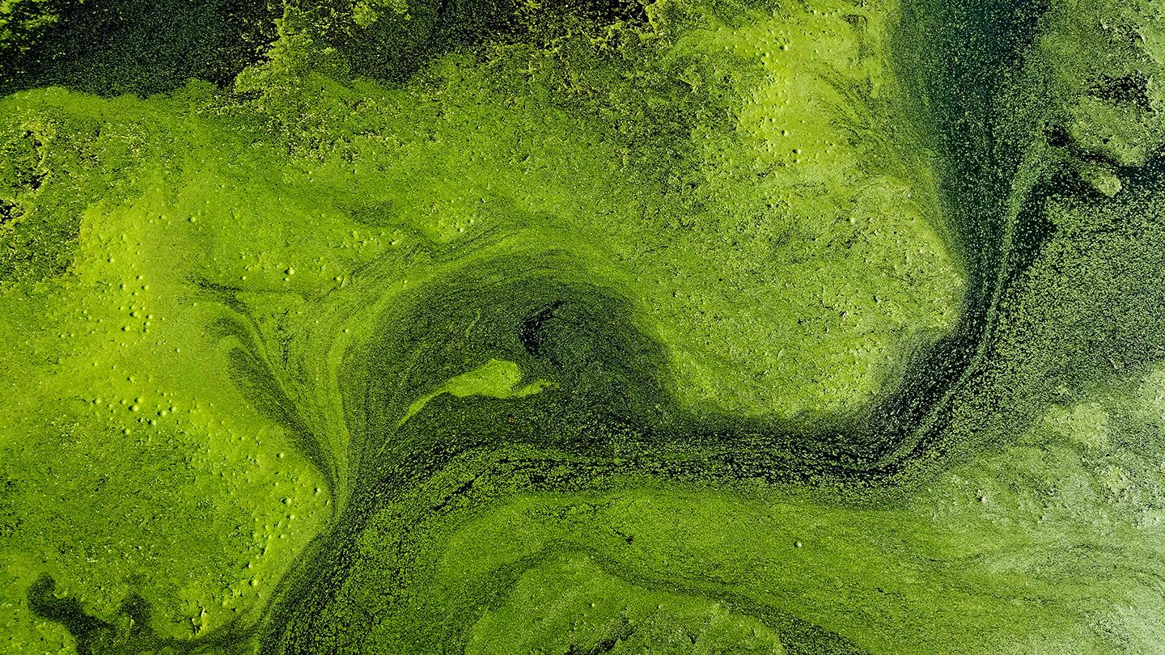
NH3 deposition endangers nature/biodiversity
(for Natura 2000 areas)
N-enrichment of soil/water
Acid deposition + eutrophication
Severe reductions in water quality
Adverse effects on aquatic ecosystems in rivers and lakes
Damage to forest, crops and other vegetation
Decreased biodiversity
Chances in species composition and dominance
Toxicity effects
[2]
Notes:
[2] European Environment Agency, “Ammonia (NH3) emissions — European Environment Agency,” 04-Sep-2015. [Online]. Available: https://www.eea.europa.eu/data-and-maps/indicators/eea-32-ammonia-nh3-emissions-1. [Accessed: 29-Aug-2021].

Slide 13
NH3 deposition endangers nature/biodiversity
(for Natura 2000 areas)
N-enrichment of soil/water
Acid deposition + eutrophication
Severe reductions in water quality
Adverse effects on aquatic ecosystems in rivers and lakes
Damage to forest, crops and other vegetation
Decreased biodiversity
Chances in species composition and dominance
Toxicity effects
[2]
Notes:
[2] European Environment Agency, “Ammonia (NH3) emissions — European Environment Agency,” 04-Sep-2015. [Online]. Available: https://www.eea.europa.eu/data-and-maps/indicators/eea-32-ammonia-nh3-emissions-1. [Accessed: 29-Aug-2021].

Slide 14
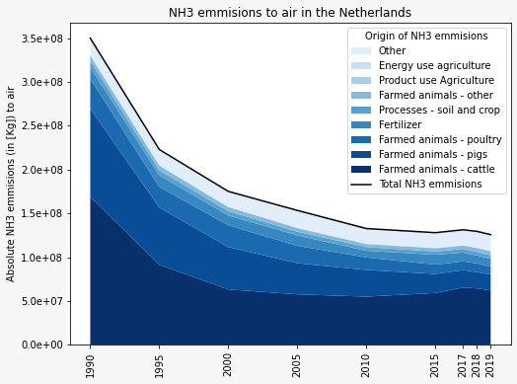

NH3 emissions mainly originate from agriculture
Total
Non-agriculture
Cattle
[3]
Notes:
[3] numbers taken from emmissieregistratie.nl, http://www.emissieregistratie.nl/erpubliek/erpub/weergave/grafiek.aspx, → for ammonia emissions to air, both the national total and the emissions originating from agriculture. Accessed 28/8/2021

Slide 15
Strict NH3 guidelines have been set
NEC directive 2010 | Total emission 2019 | Gothenburg ceiling 2020
128 Kton | 125.8 Kton (107.5 Kton from agriculture) | 123 Kton
[4]
Notes:
[4] Rijkswaterstaat Ministerie van Infrastructuur en Waterstaat, “NEC-stoffen - Kenniscentrum InfoMil.” [Online]. Available: https://www.infomil.nl/onderwerpen/lucht-water/lucht/nec-stoffen/. [Accessed: 29-Aug-2021].

Slide 16
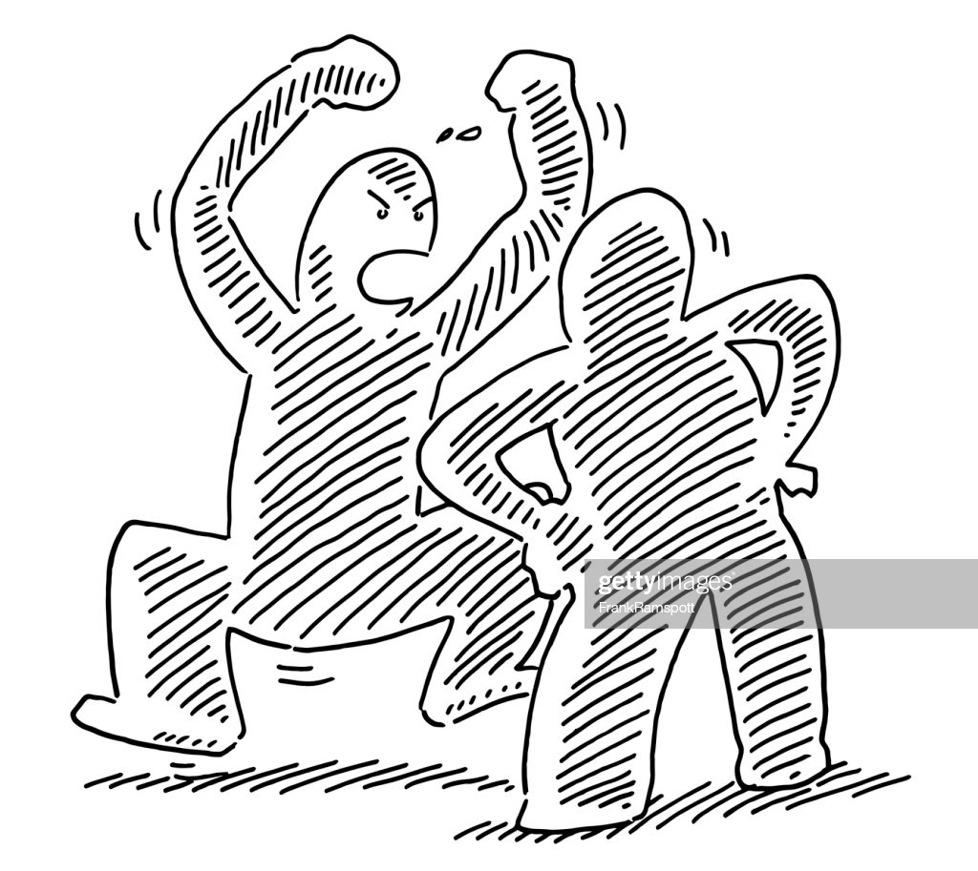
Current approach to the problem
Curb agriculture!
No more expansion → very strict rules/certificates
Half livestock (?)
Great threat to income farmers
Threat to worldwide food security → the Netherlands is #2 exporter [5]
Currently:
  Farmers protest / diminished social cohesion
  Paralyzation farming expansion
  Barely making goals / still biodiversity threat
New solution is needed to protect nature, give farmers financial stability and ensure sufficient food supply
Notes:
[5] Dolman, Mark, Gerben Jukema, and Pascal Ramaekers. 2019. “De Nederlandse Landbouwexport 2018 in Breder Perspectief.” Wageningen Economic Research. https://doi.org/10.18174/468099 (September 23, 2021).

Slide 17
Our solution

Slide 18
iGEM Groningen 2021
We aim to find a new solution to the nitrogen (NH3) crisis that:
  Prevents NH3 emission at the source (agriculture-cattle)
  Therefore prevents/limits harmful effects on nature
  Does not produce harmful substances
  Is viable/sustainable over a longer period of time
  Actually brings something positive for the farmers
  Safe & circulair

Slide 19




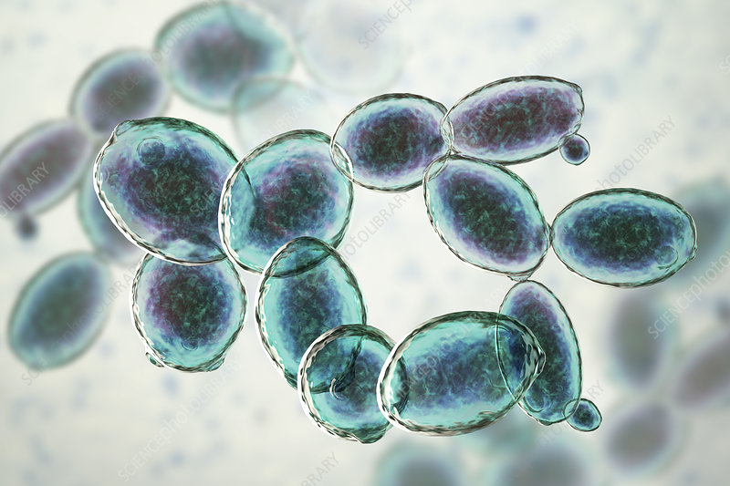
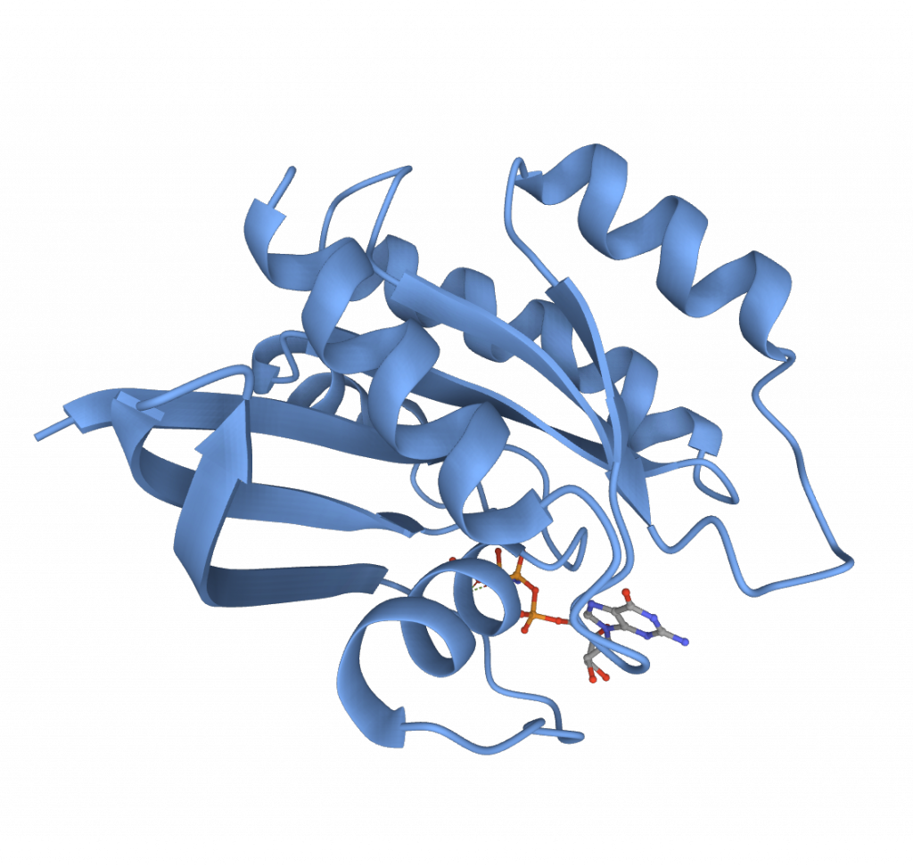
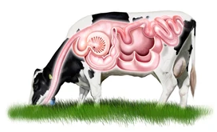
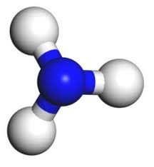
Our proposal
Bakers yeast
Feed additive
Digestion
Less N excretion
Enzyme that can be purified and added to livestock feed
Cattle will more efficiently digest the feed
Less nitrogen to feces → less ammonia
Widely used in synthetic biology
kill switch
best combination of genetic elements
more growth and milk production

Slide 20
Our proposal
Excess ammonia will be captured by a MOF (in cattle and poultry barns) and fed as a nitrogen source to the yeast
Bakers yeast
Feed additive
Digestion
Less N excretion

Slide 21
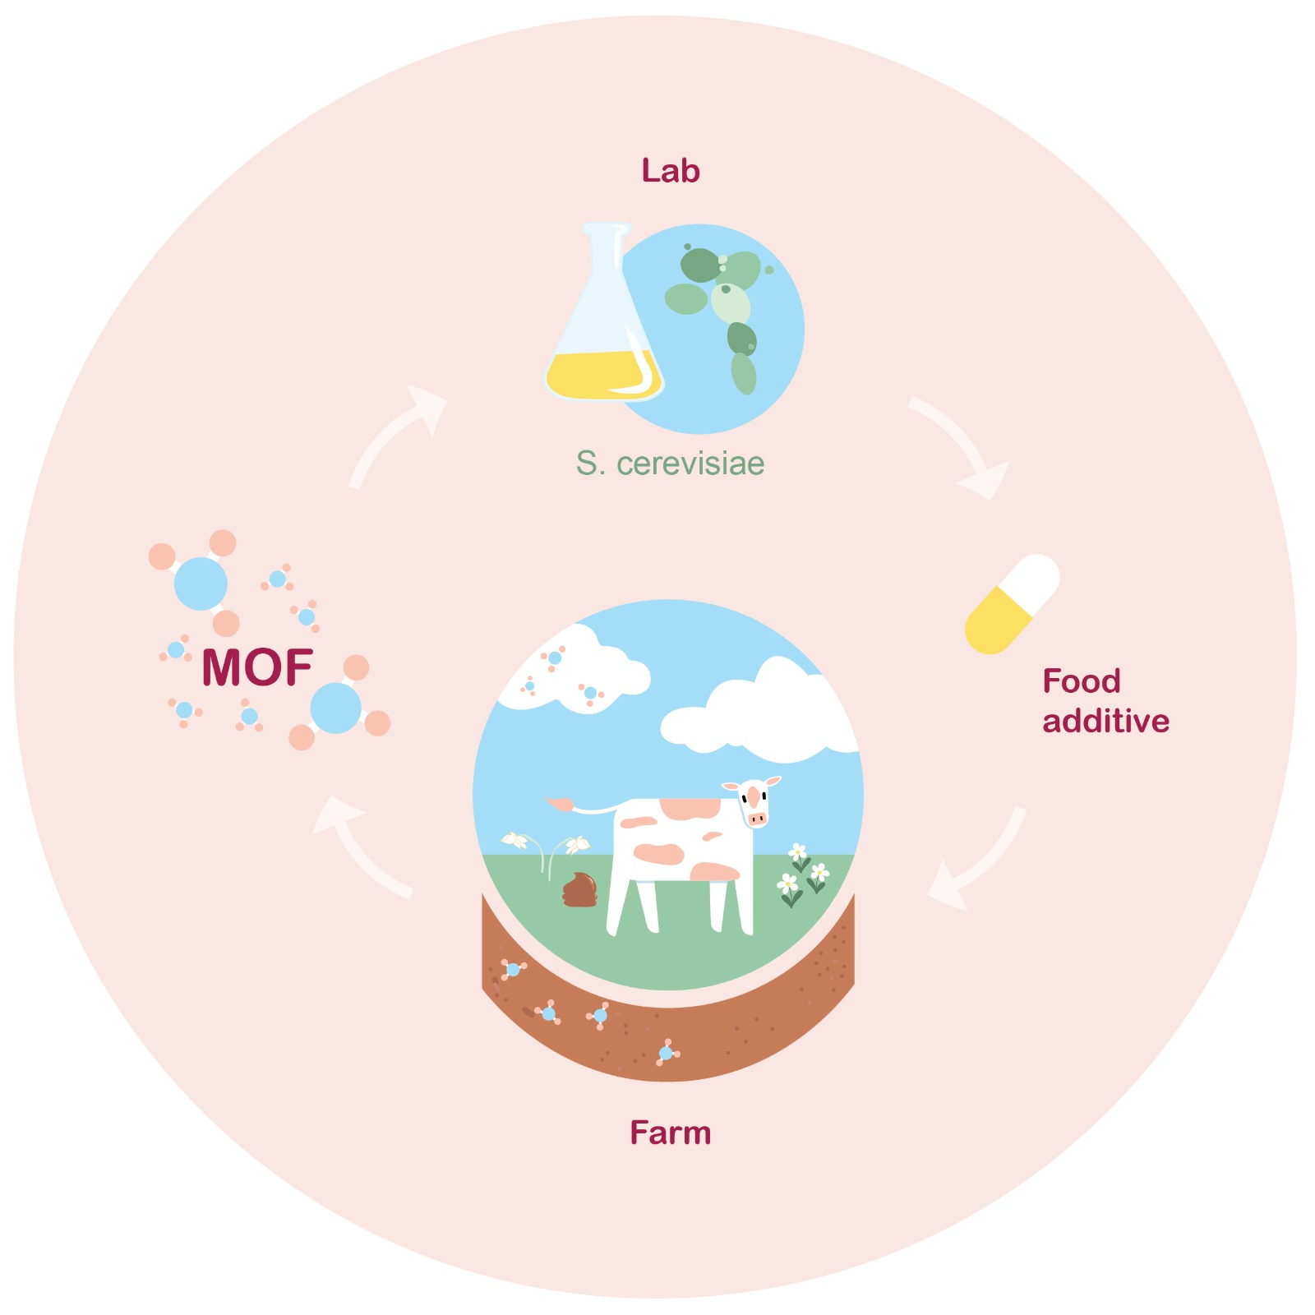
Key values of our project
Maximal production, minimal resources
Circulair
Targets the source
Beneficial to farmers
Safe

Slide 22

Critical remarks about our project
Unsure what the feed additive does to CH4 emissions of cattle
A lot is still unknown about the MOF
Our project does not tackle NOx
Our project probably works best in combination with different solutions that prevent ammonia emissions

Slide 23
Are there any questions?

Slide 24
Break out rooms
After break: join the groupcall with your party members
The standpoint of your stakeholder + winning condition + dilemma will be given
Appoint a group speaker
Have a discussion how to solve the dilemma
At the end: Formulate a conclusion
After break-out rooms: present conclusion and react to others
After speech and rebuttal: conclusive discussion

Slide 25
Time table
Introduction (30 min)
  Why are we doing this?
  What is iGEM?
  What is the problem?
  What is our solution?
---- Break ----
Breakout rooms (15 min)
---- Break ----
Speech & rebuttal (10 min)
Conclusive discussion (10 min)

Slide 26
Break

Slide 27
Breakout rooms

Slide 28
Break

Slide 29
Speech and rebuttal

Slide 30
Scientists
Your numbers are used to defend the project. However, people do not trust the accuracy of the numbers. What do you do?

Slide 31
Ecologists
Not everyone sees the need to spend money on the project because they do not see the need to protect nature from excess ammonia. What do you do?

Slide 32
Farmers
The project is not enough to allow expansion of your farm. (When) would you still use the project?

Slide 33
Government
The project is not enough to get below emission ceilings. Farmers still have to follow additional measures and are upset. How do you meet both economical and environmental needs?

Slide 34
Regular citizens
The project is discussed in jargon/incomprehensible language. You are not convinced of the safety of the project. What is needed to make the project understandable and feel safe?

Slide 35
Conclusive discussion

