Slide 1

SYNTHETIC BIOLOGY 101

Slide 2



Central Dogma of Molecular Biology
Transcription
Translation
1 . DNA
2 . RNA
3. Protein

Slide 3
1 . DNA
1 . DNA
Double stranded
Double helix
Made of ACGT bases
A pairs with T
C pairs with G
Unique for every individual

Slide 4
2 . RNA
Transcription converts DNA to RNA
Single stranded
Made of ACGU bases

Slide 5
3 . Protein
Translation converts RNA into proteins
Made of amino acids
Every three bases in RNA codes for a single amino acid
Responsible for many cell processes

Slide 6


What is synthetic biology ?
Laboratory editing of DNA, RNA or proteins
Can change colour, shape, size, function, etc. of cells
Glowing red E. coli
Normal E. coli

Slide 7

What do synthetic biologists do ?
Many techniques to edit DNA, RNA, proteins
3 common techniques
Digestion / ligation
PCR amplification
Gel electrophoresis

Slide 8




Digestion / Ligation
Restriction site
Restriction enzyme

Slide 9
Digestion / Ligation
Enzyme binding

Slide 10
Digestion / Ligation
Restriction digestion

Slide 11




Desired insert
Digestion / Ligation
DNA ligase

Slide 12

Digestion / Ligation

Slide 13

Digestion / Ligation
Repaired DNA

Slide 14

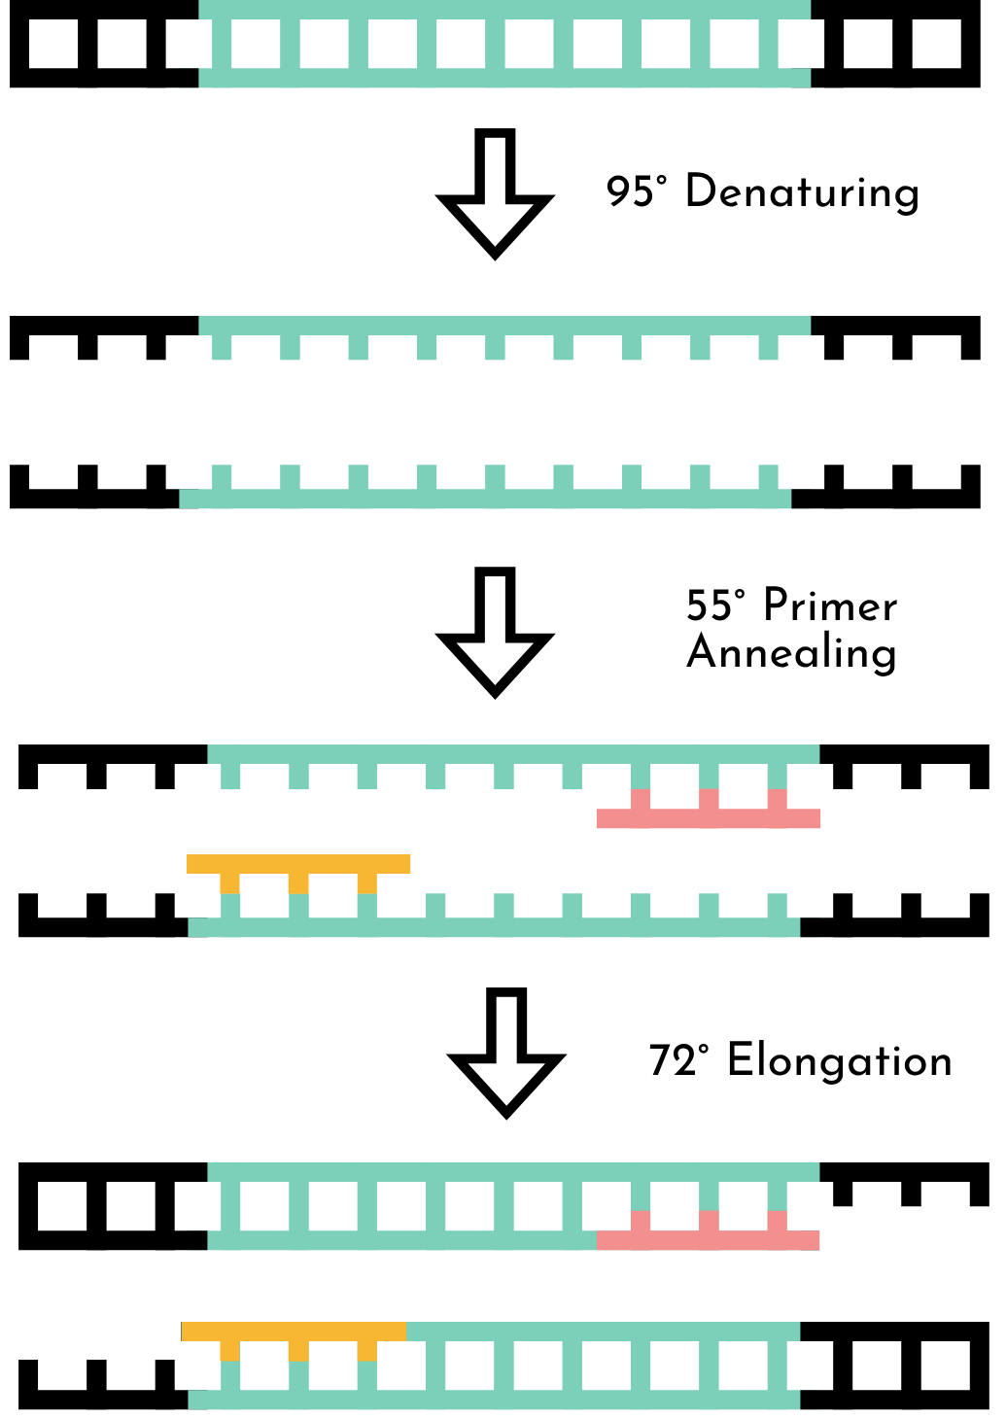
PCR Amplification

Slide 15
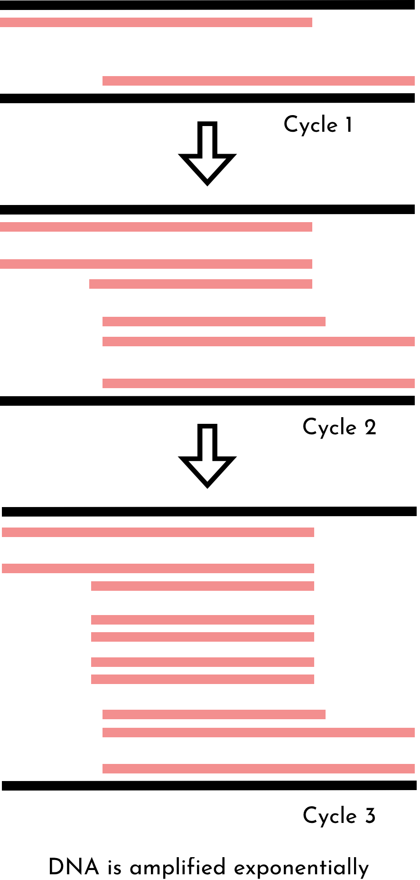
PCR Amplification

Slide 16

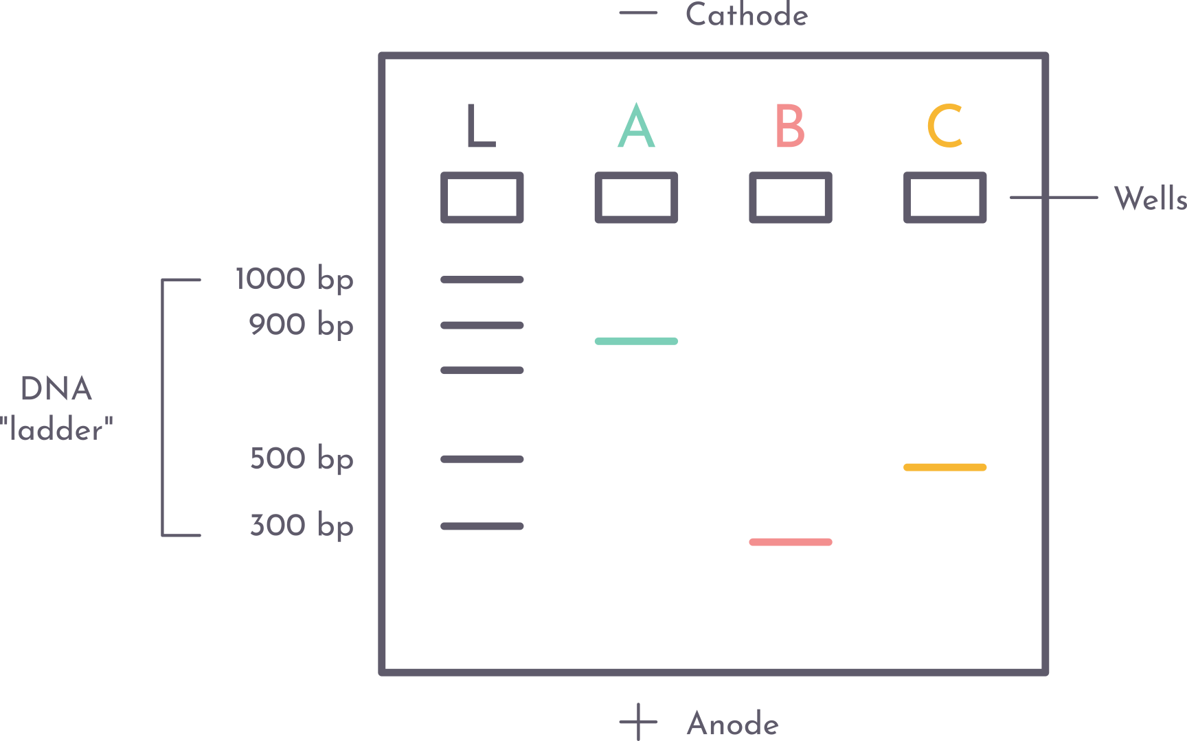
Gel Electrophoresis

Slide 17
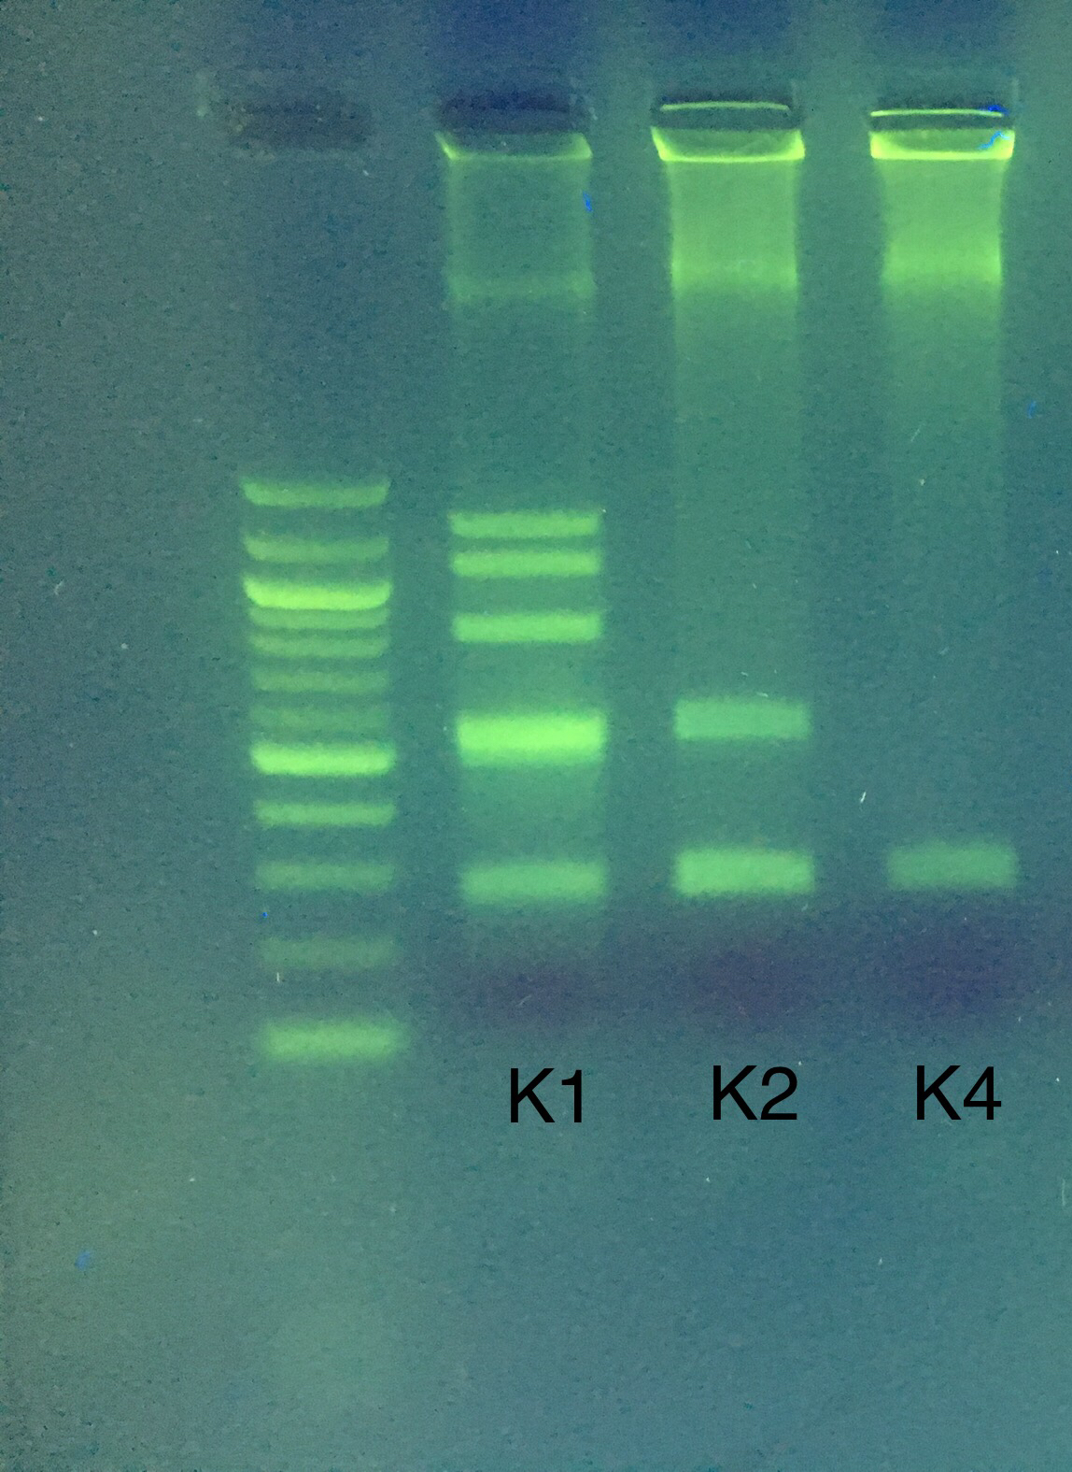
Gel Electrophoresis
1000 bp
500 bp
290 bp
100 bp

Slide 18

STRAWBERRY DNA EXTRACTION

