Slide 1
An Enzyme Coupled Biosensor enables (S)-reticuline Synthesis in Yeast
John E. Dueber, William C. Deloache, Zachary N. Russ, Lauren Narcross, Andrew M. Gonzales, Vincent J. J. Martin
Presented by: Emma Finlayson-Trick and Landon Getz

Slide 2
Drug
Low yield
Cost ineffective
Plant growth dependent
Notes:
This paper deals with the production of pharmaceuticals from plant metabolites in work horse organisms. Plant metabolites are chemically diverse and are used in the development of a large number of pharmaceuticals. For instance, the poppy is used for the production of heroin which is type of opioid that has pain reducing properties
Manufacturing pharmaceuticals from plant extract is not efficient as production is not only dependent on the successful growth of the plant, but there is low yield even with successful growth

Slide 3
Complex Biochemical Pathway
Elucidated Pathway
L-Tyrosine
????????
Next Generation Sequencing
L-DOPA
????????
Dopamine
????????
S-reticuline
Notes:
In the past, what has slowed down the production of pharmaceuticals by total organic synthesis is the complexity of the metabolic pathways. The pathways are often not very well understood which hinders using synthetic techniques to optimize production
However, now techniques such as next-gen sequencing have clarified the complexity of many of the plant biochemical pathways such that these pathways can be genetically manipulated and engineered into a host such as E. coli for industrial production
Various synthetic biology techniques has made manipulating organisms faster, cheaper and easier
Synthetic biology described as artificial design and engineering of biological systems and living organisms for purposes of improving applications for industry or biological research

Slide 4
Benzylisoquinoline alkaloids
(BIAs)
Morphine
Noscapine
Codeine
Papaverine
Notes:
This paper focuses on plant metabolite known as BIAs which have a variety of therapeutic uses
Until recently, the chemical complexity of most BIAs meant that they couldn't be chemically synthesized at a commercial scale and thus production required tedious extractions from plants
Through next gen sequencing the complicated pathway was illuminated and thus BIAs are now a viable target for production via microbial fermentation

Slide 5
Previous Experiments
L- Tyrosine
L-DOPA
Dopamine
S-Reticuline
BIAs
Glucose
S-reticuline
Notes:
As indicated in the pathway at the top of the screen, the production of BIAs requires several key intermediates which are controlled by specific enzymes. For the next few slides, they pathway will remain at the top of the screen as I elaborate on experiments done previously in this field.
To begin, researchers managed to engineer E. coli to use glucose in the production of s-reticuline. This step is important as s-reticuline is the last major intermediate that is shared amongst the major BIA pathways.
What was interesting to learn was that when the researchers reconstituted S-reticuline in E. coli there was no further downstream synthesis of BIAs. But when S-reticuline was reconstituted in yeast downstream production occurred which has lead to the production of many valuable BIAs but from cost prohibitive intermediates
Yeast are capable of this downstream BIA biosynthesis because they can functionally express an enzyme family known as cytochrome P450 which plays an important role in BIA synthesis and diversification

Slide 6
Previous Experiments
L- Tyrosine
L-DOPA
Dopamine
S-Reticuline
BIAs
NCS
Tyrosine Hydroxylase
L-tyrosine
L-DOPA
Notes:
One of the next logical steps was to form a co culture of yeast and reticuline producing E. coli and although in a lab setting cocultures and sequential fermentations are okay, if this process was to ever be used on an industrial scale, monocultures would provide ultimate productivity.
From these previous experiments it was clear that the research team had to engineer an organism capable synthesizing BIAs from start to finish- the yeast! I should say that the researchers never actually did this due to ethical concerns which Landon will touch on later.
Unfortunately the production of s-reticuline in has been difficult primarily due to the first biosynthetic step of L-tyrosine to L-DOPA and poor activity of norococlaurine synthase (NCS) which is an enzyme that modifies dopamine allowing for continuation of the pathway
In this presentation we are focusing on the first problem- the biosynthetic step of using L-tyrosine to produce L-DOPA
Yeast has trouble with this crucial step as it fails to have a copper cofactor which is needed for the use of the enzyme tyrosine hydroxylase (a member of the cytochrome P450 family)
Copper containing tyrosinases exhibit tyrosine hydroxylases exhibit DOPA oxidase activity such that the enzyme when copper is available can convert L-tyrosine to L-DOPA
What the researchers needed to do was search for a yeast- active tyrosine hydroxylase

Slide 7
The Experiment
Biosensor
L- Tyrosine
L-DOPA
Dopamine
S-Reticuline
BIAs
L-DOPA
Betaxanthin
Notes:
To find a tyrosine hydroxylase that functioned in yeast, the researchers developed an enzyme- coupled biosensor that focused on the BIA pathway intermediate L-DOPA
Starting with L-DOPA, the plant enzyme DOPA dioxygenase formed betaxanthin which was used an a colorimetric tool as increased or decreased production was visualized as well as quantified via cellular florescence by either a more or less yellow phenotype
The researchers identified a tyrosine hydroxylase that was functional in yeast and therefore the world of BIA synthesis is one step closer to developing a microorganism that is capable of producing high value BIAs at a commercial scale

Slide 8
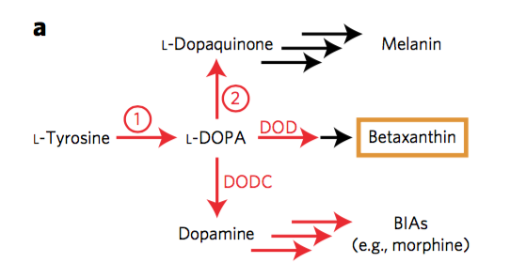
Notes:
As Emma Mentioned, the initial step in (S)-reticuline synthesis was a difficult step for yeast. So the first thing the researchers had to do was find a yeast active tyrosine hydroxylase to go from L-Tyrosine to L-DOPA.
From there, the L-DOPA would be transformed into Dopamine using a DOPA Decarboxylase.
The DOPA Dioxygenase allowed the researchers to make a colourmetric analysis of L-DOPA production and allowed for quick screening of active tyrosine hydroxylases

Slide 9
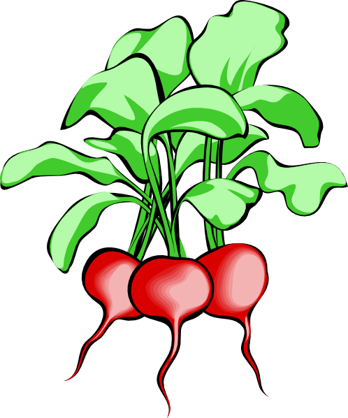

Plug and Play...
Common Mushroom - Agaricus bisporus
Common Beet - Beta vulgaris
Both contain L-Tyrosine Hydroxylases!!!
Screening made easy with DOD
Both images from ClipArtpanda.com
Notes:
This colourmetric tool allowed for a “plug and play” system. The researchers found active tyrosine hydroxylases in the common mushroom A. bisporus and the common beet Beta vulgaris. They were transformed into yeast and their activity was screened by the yellow-ness of the yeast cells.

Slide 10
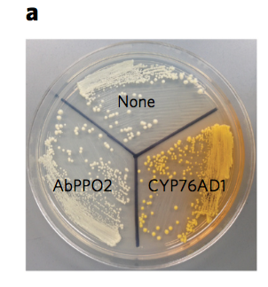
AbPPO2 - Mushroom Tyrosine Hydroxylase
CYP76AD1 - Beet Tyrosine Hydroxylase
The Beet is the Winner!
But…
Can it be made better?
Notes:
Define the labels on the picture
Right out of the gate, the beet tyrosine hydroxylase seemed to be the winner.
But…Can it be made better?

Slide 11
Notes:
Tyrosine hydroxylases have an unwanted oxidase activity. This activity takes L-DOPA and sends it down a pathway that leads to melanin. This removes L-DOPA from becoming Dopamine and eventually morphine. This problem lead the researchers to wonder if the enzyme truly could be made better.

Slide 12
PCR Mutagenesis
PCR uses a heat stable polymerase to extend DNA.
Temperature increase causes DNA to melt
Slightly lowering temperature allows primers to anneal
Polymerase extends DNA
Cooled to stop Polymerase action
65℃
95℃
10℃
Notes:
Why do we do PCR?

Slide 13
PCR Mutagenesis
DNA polymerase can be made error-prone by changing reaction conditions:
Increase Mg2+ Concentrations
Add Mn2+
Unequal Concentrations of DNA nucleotides in Solution
Use of error-prone polymerases like Taq
65℃
95℃

Slide 14
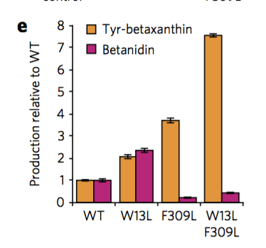
PCR Mutagenesis
Many mutant enzymes were made!
Screening was made easy due to Betaxanthin production.
Less oxidase activity = more Betaxanthin!

Slide 15
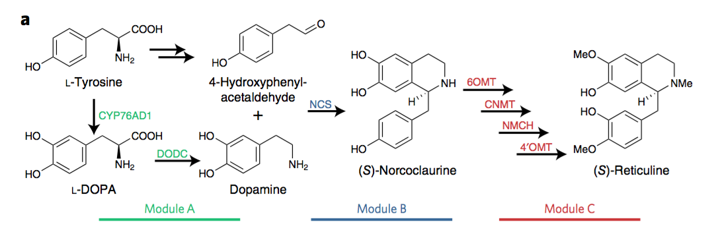
The rest is easy...
Notes:
Module A contains mutant tyrosine hydroxylase and DODC. Module A and B were integrated into chromosome using yeast integration plasmids and homologous recombination. Module C was found on a low copy number plasmid.

Slide 16
“there is probably no act, for instance, which does good to anyone without doing harm to someone else, and vice versa.”
~W. D. Ross “The Right and the Good” 1930
Notes:
This quote nicely summarizes the morphine issue. A shortage has led to suffering because pain patients do not receive the necessary treatment. Overuse and abuse of opiods however must be considered when talking about increasing availability of drugs like morphine. So where does the solution lie?

Slide 17

Morphine and other opiate shortages are frequent
The Problems

Slide 18
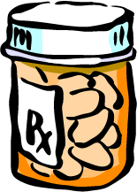
Nearly 2 Million Americans in 2014 abused opioids
~CDC
Opioids are addictive and not the only solution for treatment of chronic pain
The Problems
Notes:
The CDC states that nearly 2 million americans in 2014 abused opioid medications. This is a problem. This problem can be made worse by the increased availability of opioids that could come from a morphine producing yeast.

Slide 19
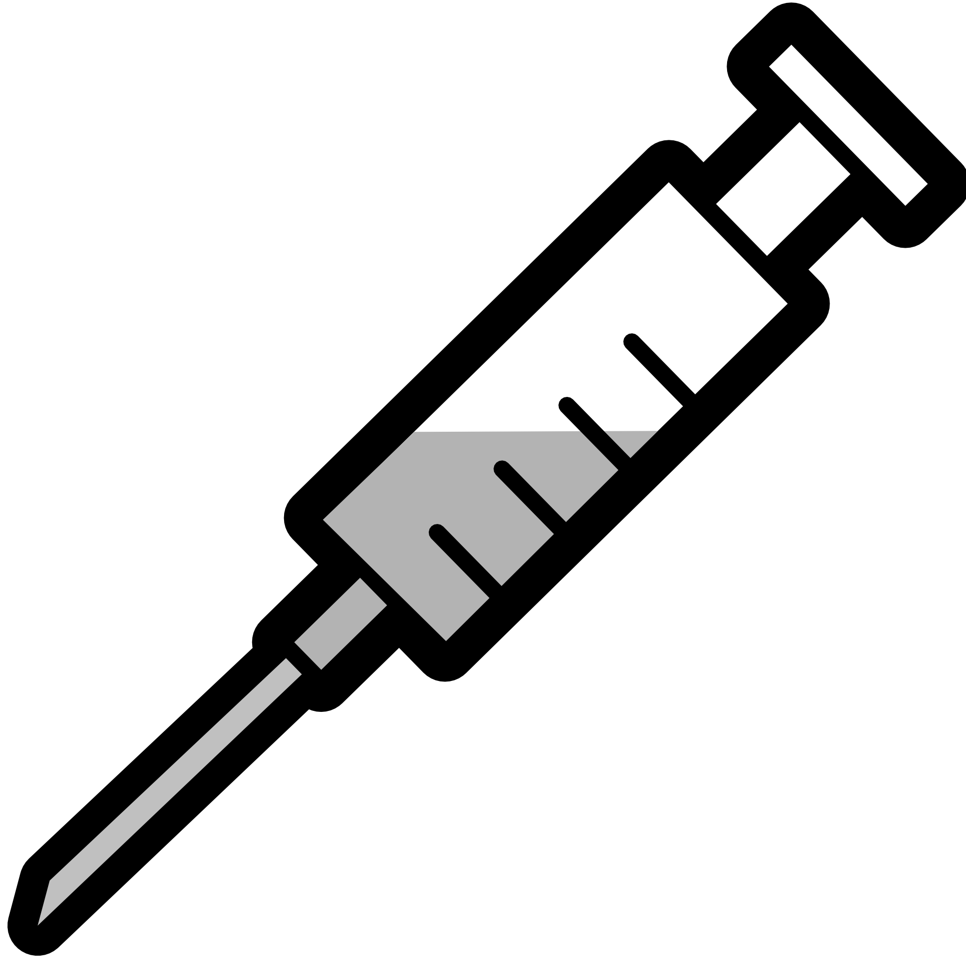
Heroin is easily synthesized from Morphine…
Morphine producing yeast could become black market money makers!
The Problems
Notes:
Heroin is usually synthesized from morphine. A morphine producing yeast could easily fuel this market.

Slide 20
Morphine producing YEAST!!
Maybe…
Not Quite...
The Solutions?

Slide 21
The CDC recommends:
Better allocation of current resources
Use of other pain treatments first
When using opioids, start low and go slow.
~CDC Guideline for Prescribing Opioids for Chronic Pain
The Solutions?

Slide 22
It’s complicated.
As it stands, addiction and abuse leads to us saying no.
But...
Replacement of plant based opioids could prevent shortages
So are Morphine Making Yeast
the Answer?

Slide 23
Future Directions
Betaxanthin
S-reticuline production in yeast
Ethical Implications
Notes:
The betaxanthin pathway could be a very useful colorimetric tool useful for studying subcellular enzyme localization and metabolite transport. Could also link the fluorescence to the production of other metabolites of interest and therefore be able to to develop high-throughput screens for additional molecules
Optimization of s-reticuline titre for production of downstream BIAs

Slide 24
Questions?

Slide 25
Sanger Sequencing
O
Tri-phosphate
BASE
O
Tri-phosphate
BASE
OH
H
H
H
Deoxynucleotide (dNTP)
Dideoxynucleotide (ddNTP)
Notes:
***Included just in case I need to explain sanger sequencing/next gen sequencing to anyone***

